Slide 1
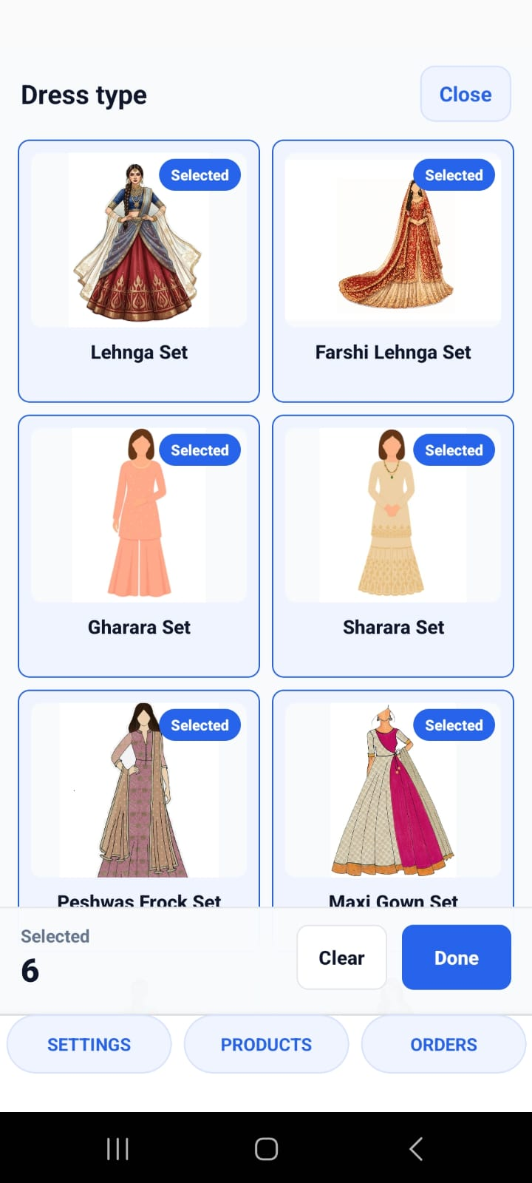
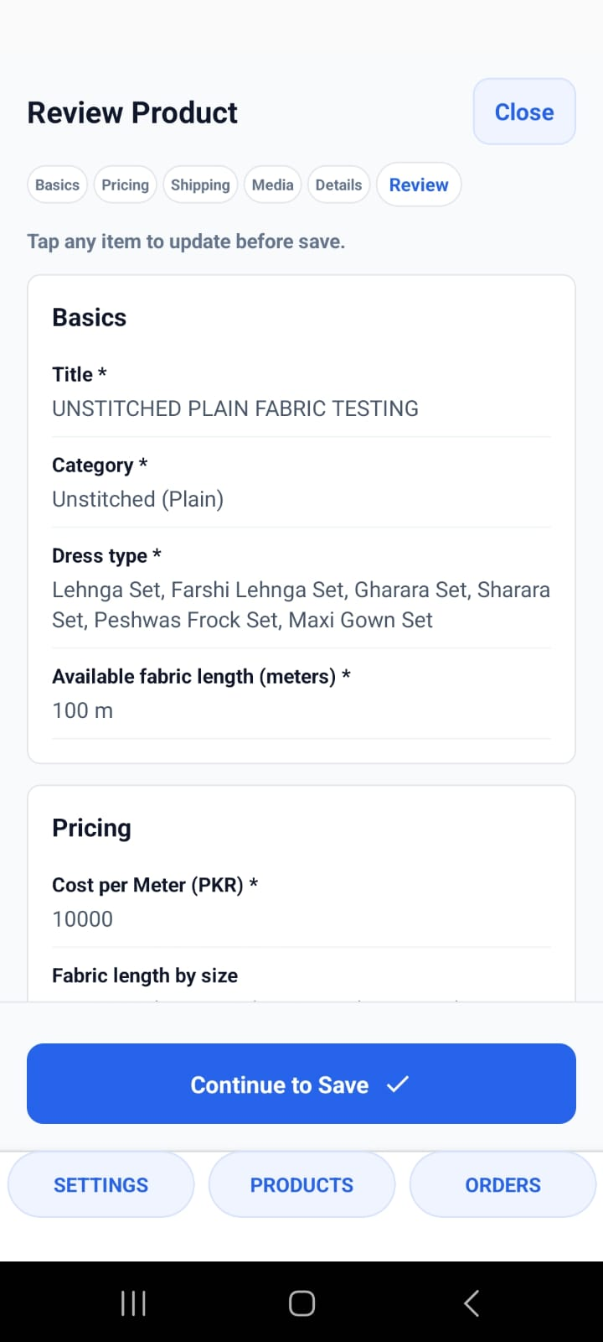
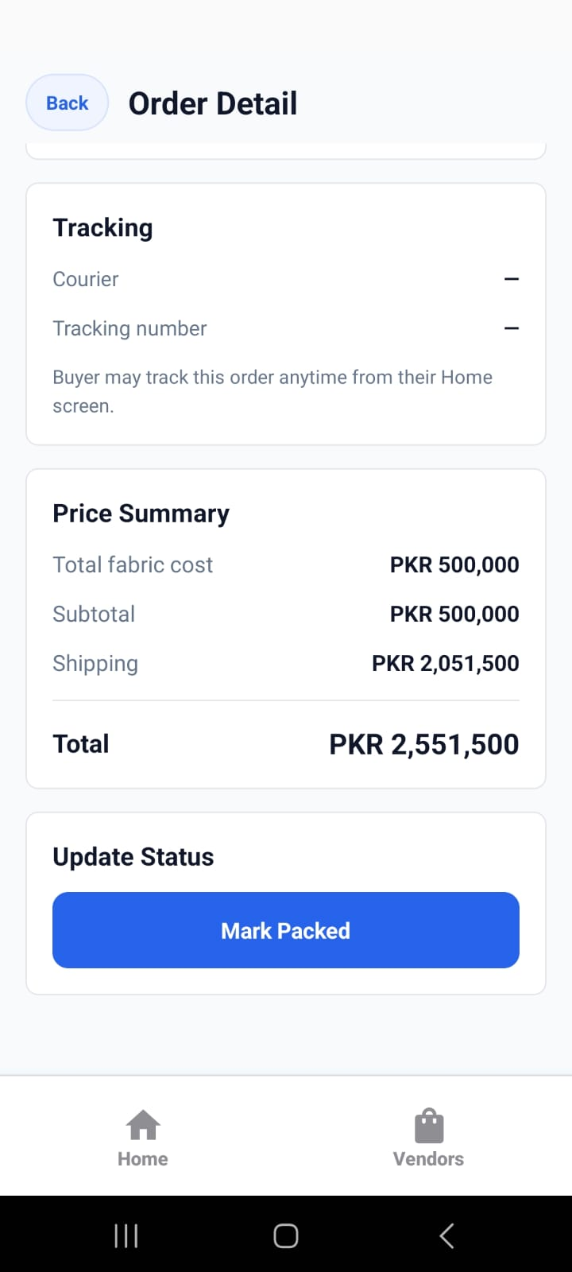
VENDOR APP WALKTHROUGH
Kapray Vendor Onboarding
Set up products, services, and orders from the vendor app screens.
Choose dress types
Review product
01
Fulfil orders
Notes:
[Sources]
User-provided Kapray screenshots: IMG-20260703-WA0168.jpg, IMG-20260703-WA0188.jpg, IMG-20260703-WA0247.jpg

Slide 2
Vendors work through one repeatable loop
Every product path follows the same operating rhythm: set up the listing, publish it, then manage buyer orders.
1
2
3
4
5
Choose product path
Add product data
Publish listing
Maintain live offers
Fulfil orders
Unstitched, ready-to-wear, or made-to-order.
Title, dress type, stock, price, shipping, media, and details.
Review the product record before it becomes visible.
Update stock, pricing, media, and sale price when needed.
Pack, dispatch with tracking, and mark delivered.
Use this loop during live onboarding: create one product, test the buyer view, then process a sample order.
02
Notes:
[Sources]
User-provided context: WhatsApp Chat with Kapray vendors onboarfing.txt

Slide 3
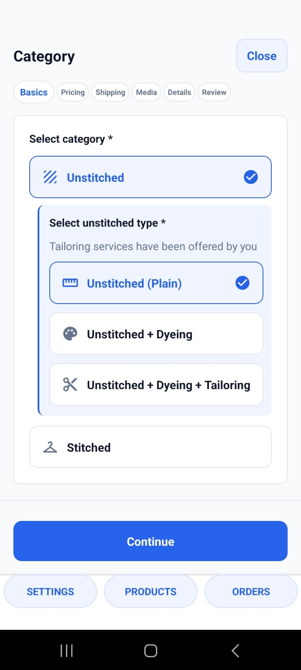
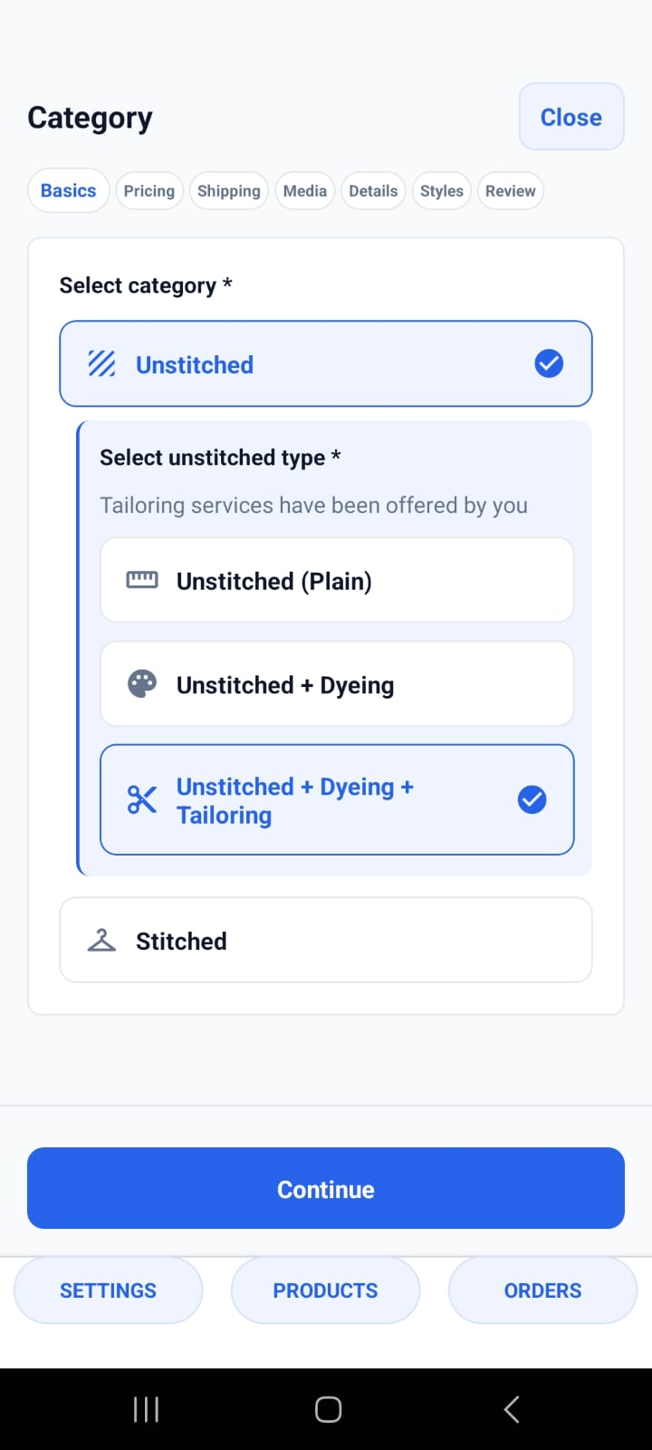
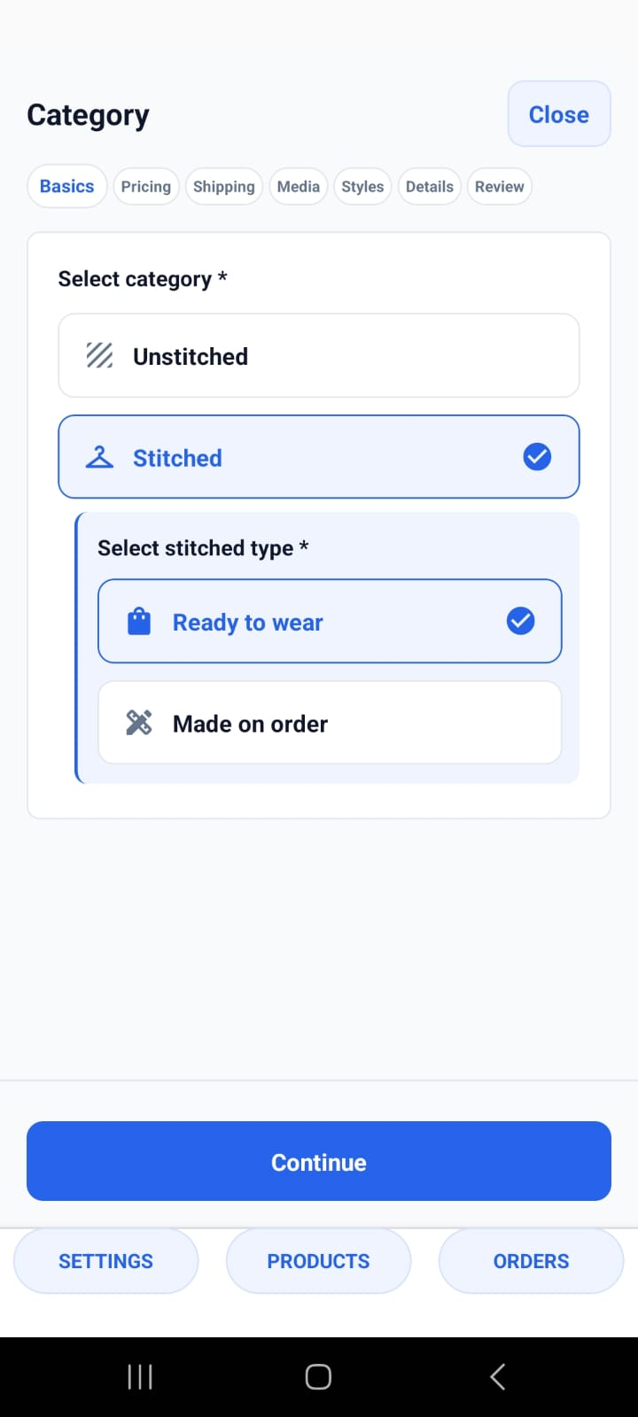
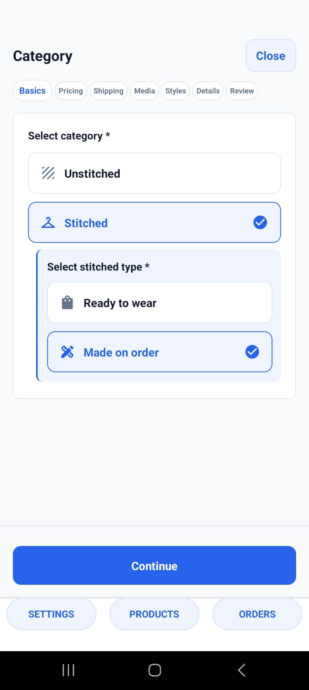
Choose the product path that matches the sale
The category choice determines the required fields and the buyer customization flow.
Unstitched plain
Dyeing + tailoring
Ready-to-wear
Made-to-order
03
Notes:
[Sources]
User-provided Kapray screenshots: IMG-20260703-WA0172.jpg, IMG-20260710-WA0008.jpg, IMG-20260710-WA0084.jpg, IMG-20260712-WA0024.jpg

Slide 4
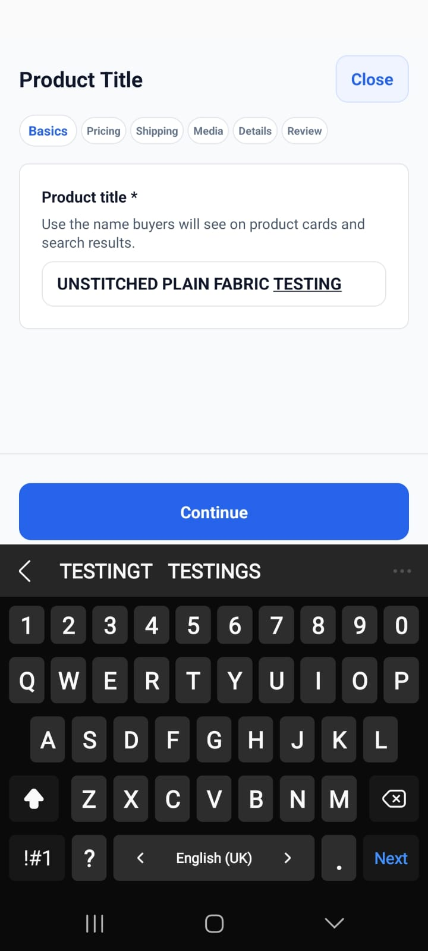
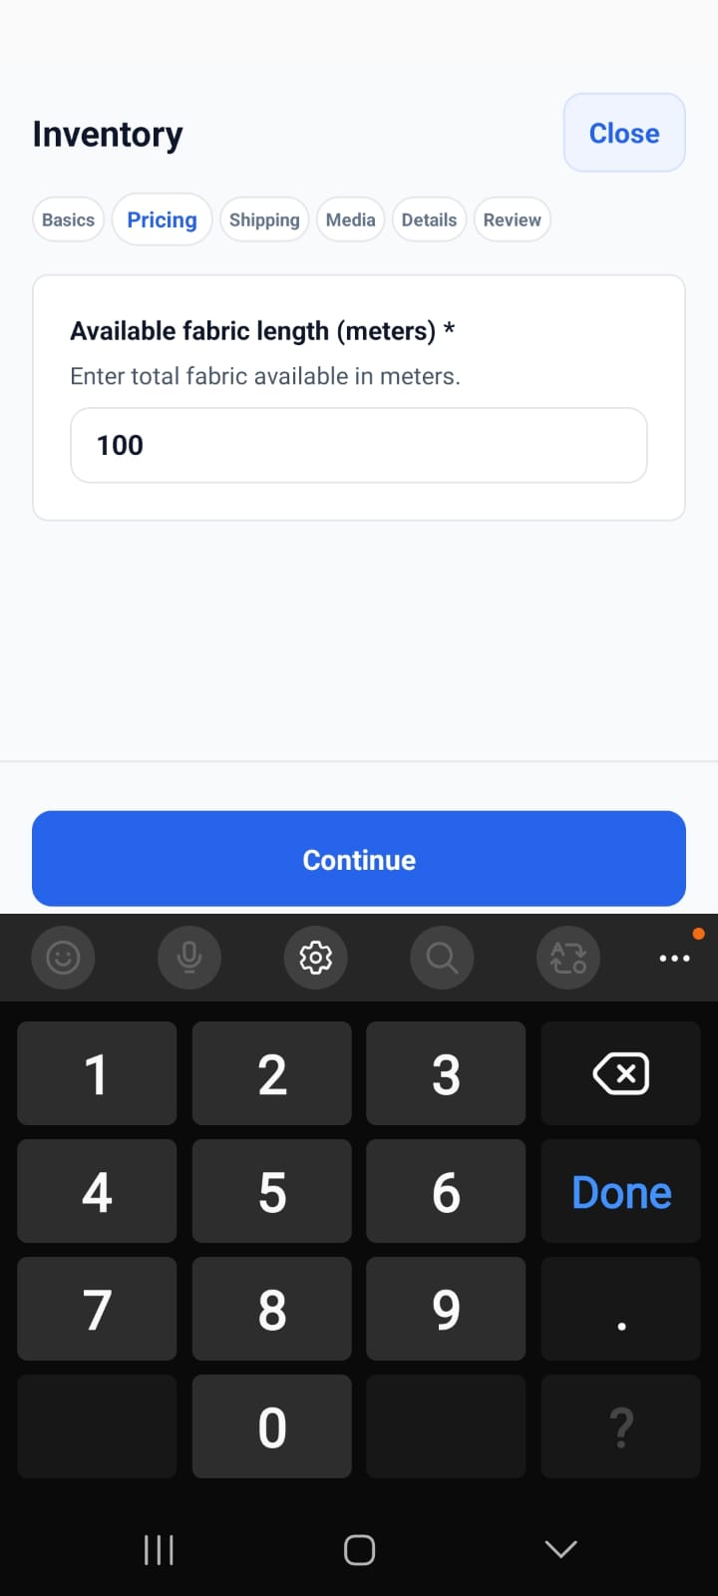
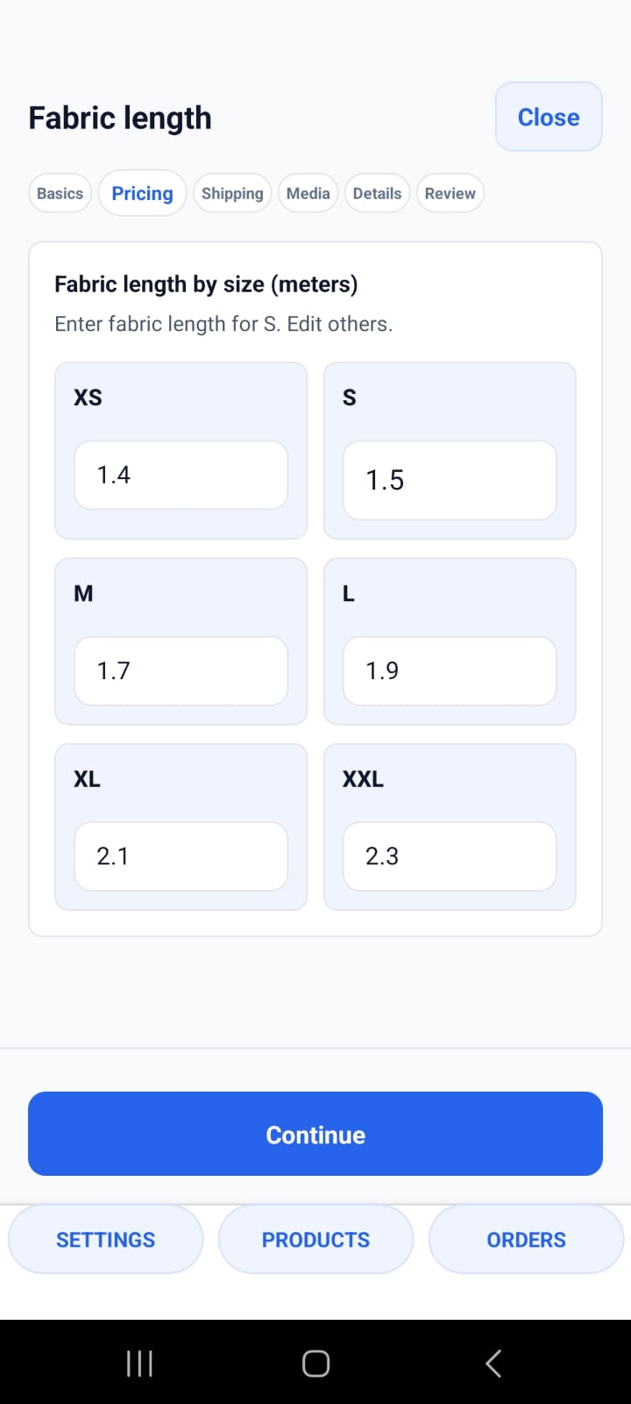
Unstitched plain captures fabric details
For plain fabric, vendors define what is being sold first: product title, stock length, base price, and available fabric lengths by size.
1
Stock in meters
2
Cost per meter
3
Size-wise fabric length
Product title
Inventory
Fabric length
04
Notes:
[Sources]
User-provided Kapray screenshots: IMG-20260703-WA0170.jpg, IMG-20260703-WA0173.jpg, IMG-20260703-WA0176.jpg

Slide 5
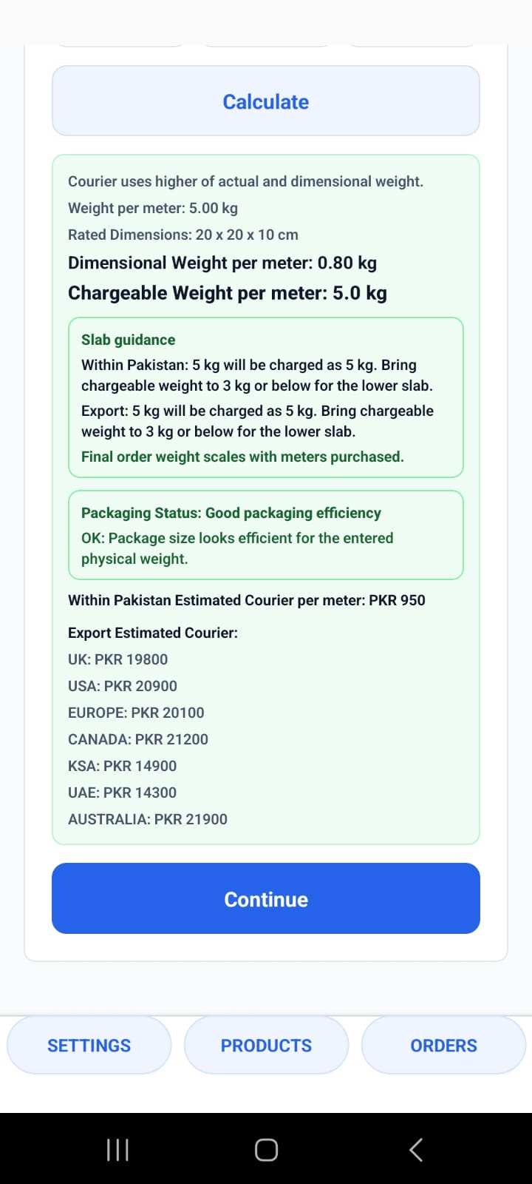
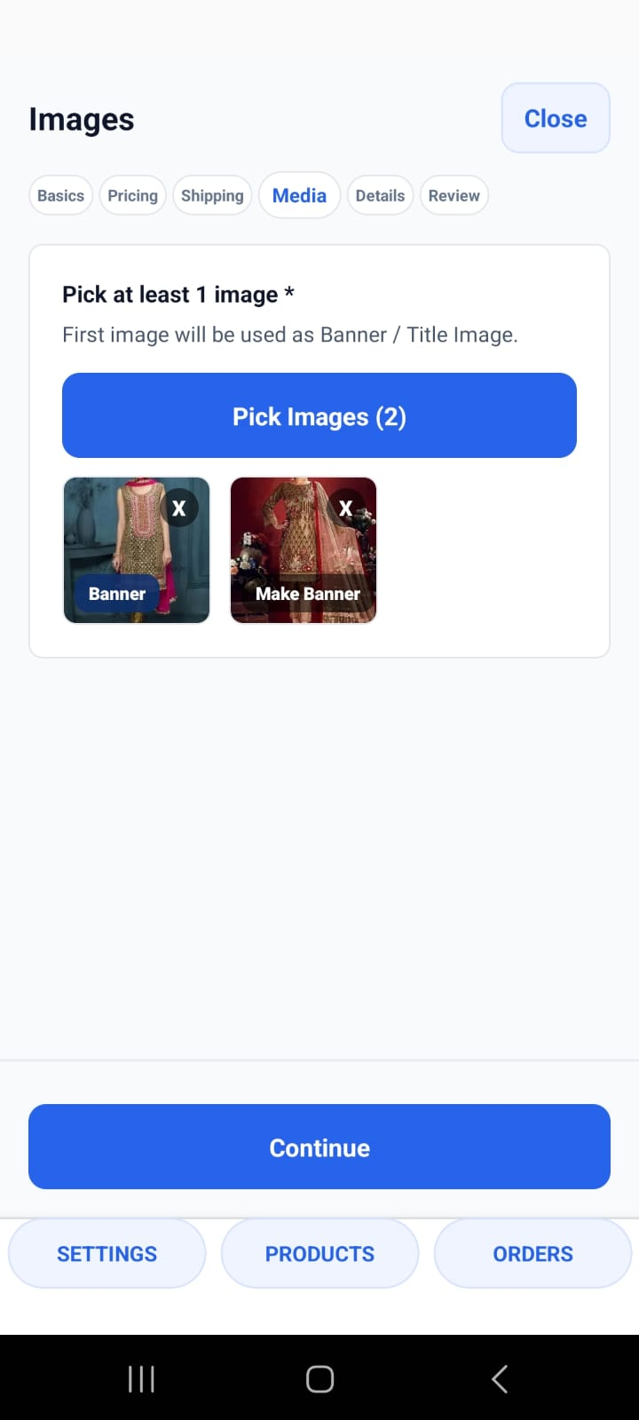
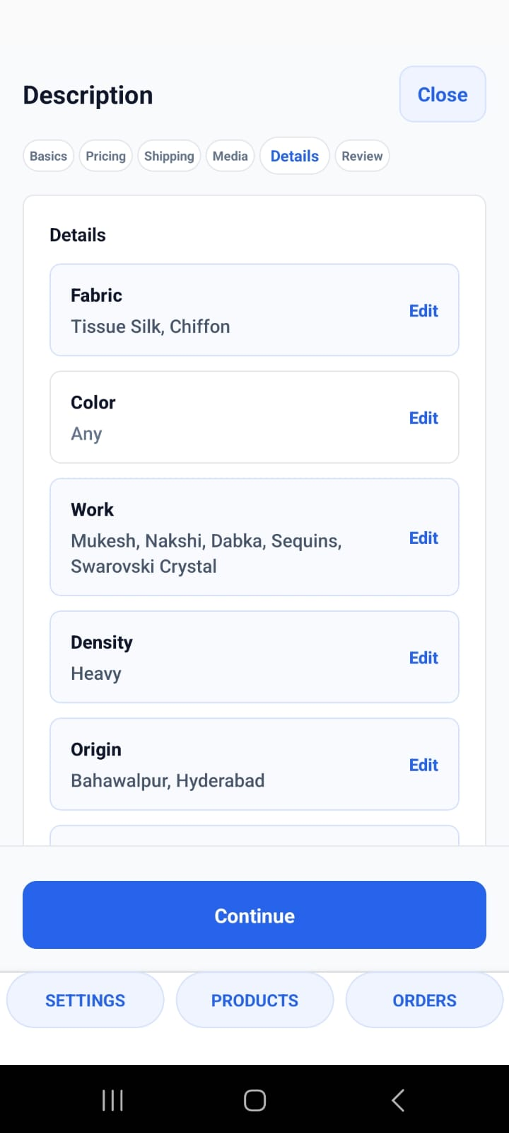
Shipping and media make listings buyer-ready
The listing becomes actionable after the vendor calculates shipping, adds images and video, and fills the product details buyers use to judge fit and quality.
1
Shipping calculator
2
Product images and video
3
Fabric, work, density, origin
Shipping
Images
Details
05
Notes:
[Sources]
User-provided Kapray screenshots: IMG-20260703-WA0179.jpg, IMG-20260703-WA0181.jpg, IMG-20260703-WA0184.jpg

Slide 6
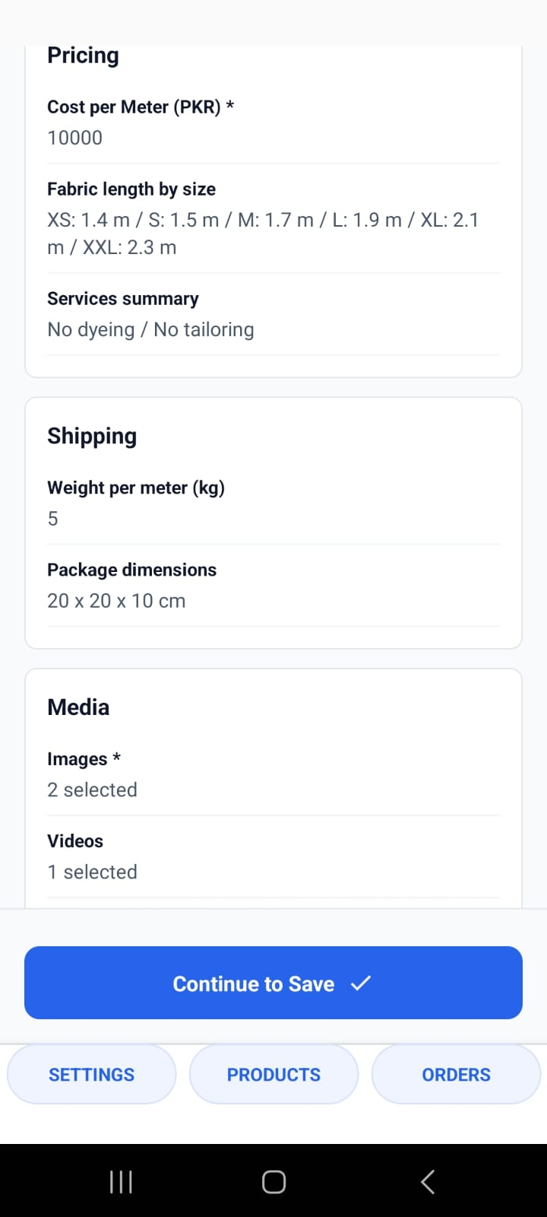
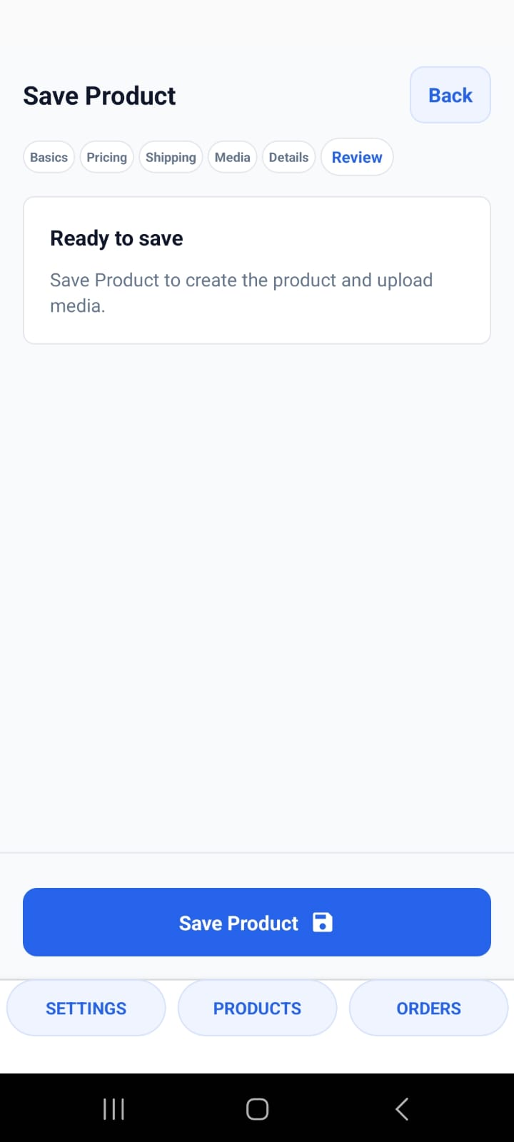
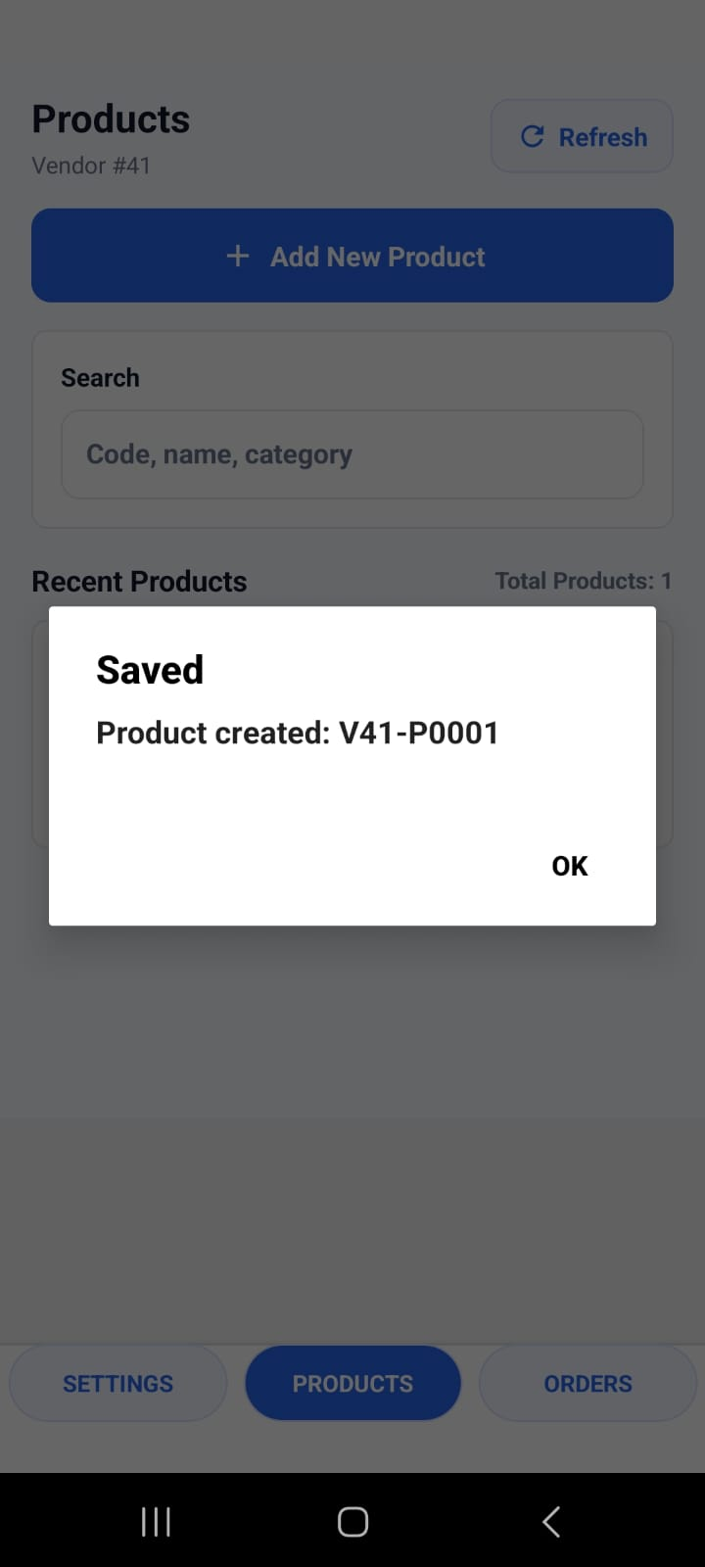
Review and publish the completed product record
The review screen gives vendors one last pass across basics, pricing, shipping, media, and description before saving.
Basics review
Pricing and shipping
Ready to save
Saved confirmation
06
Notes:
[Sources]
User-provided Kapray screenshots: IMG-20260703-WA0188.jpg, IMG-20260703-WA0189.jpg, IMG-20260703-WA0191.jpg, IMG-20260703-WA0192.jpg

Slide 7
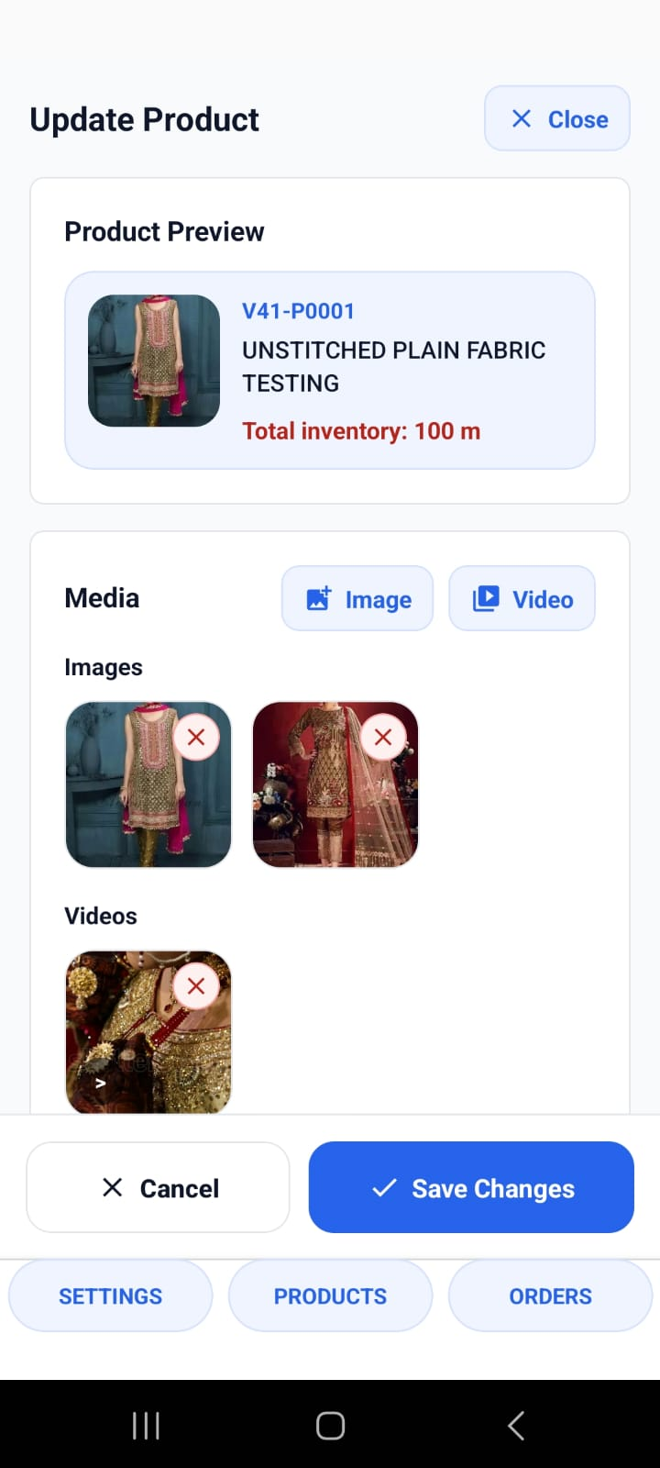
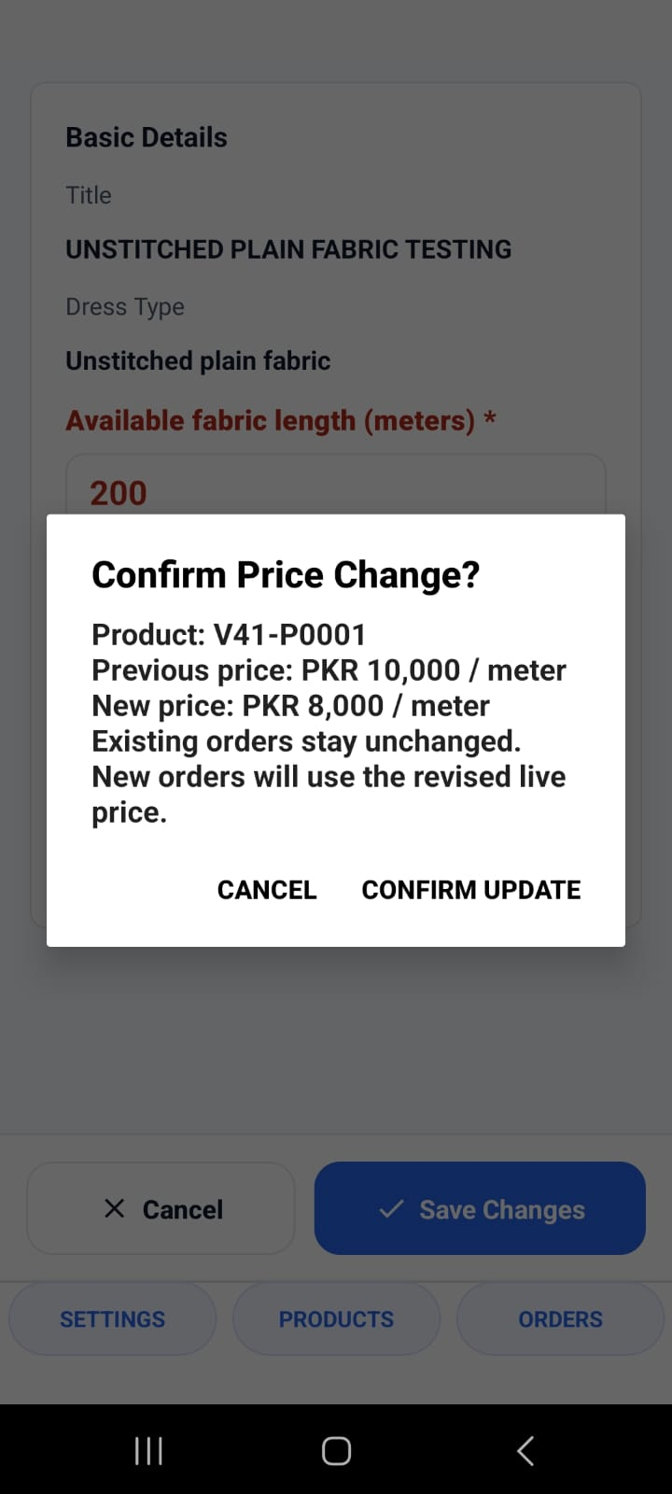
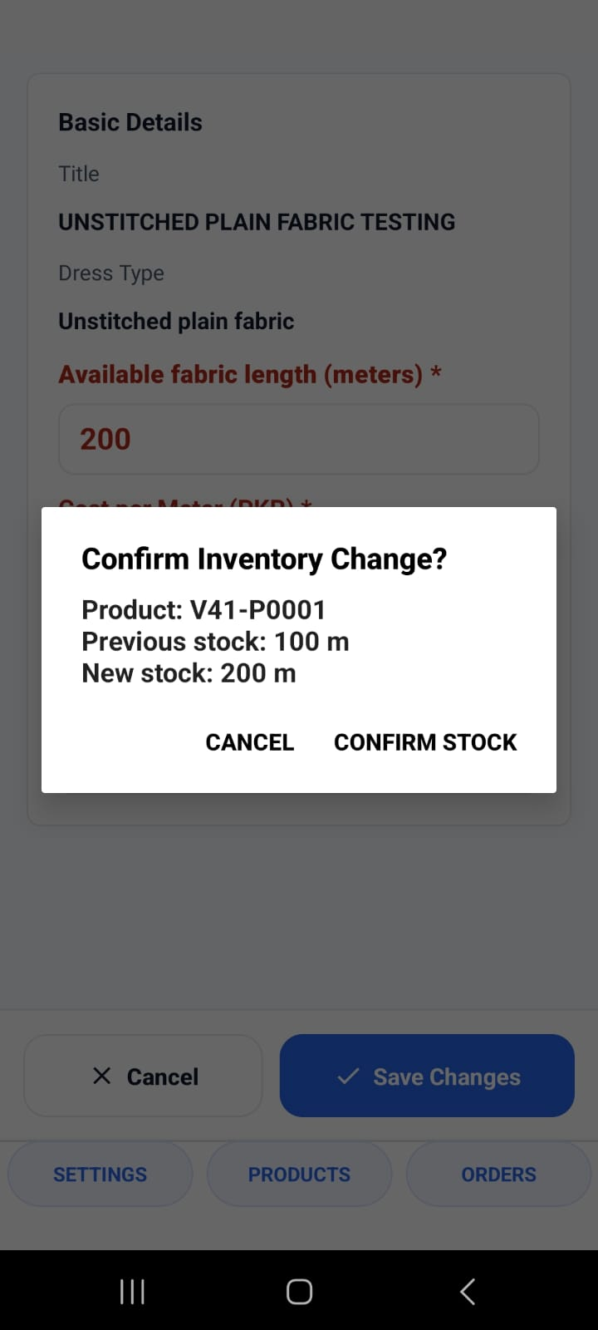
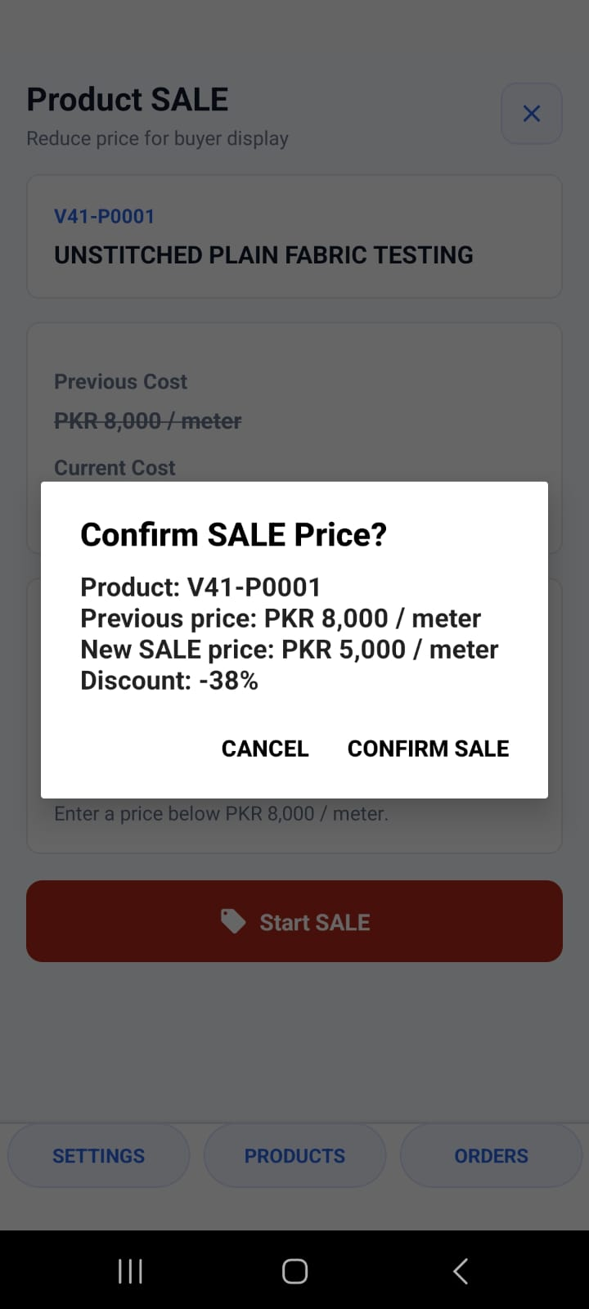
Update live products with explicit confirmations
Vendors can revise stock, price, media, and sale pricing with explicit confirmation prompts.
Update product
Confirm price
Confirm stock
Confirm sale
07
Notes:
[Sources]
User-provided Kapray screenshots: IMG-20260703-WA0197.jpg, IMG-20260703-WA0201.jpg, IMG-20260703-WA0202.jpg, IMG-20260703-WA0207.jpg

Slide 8
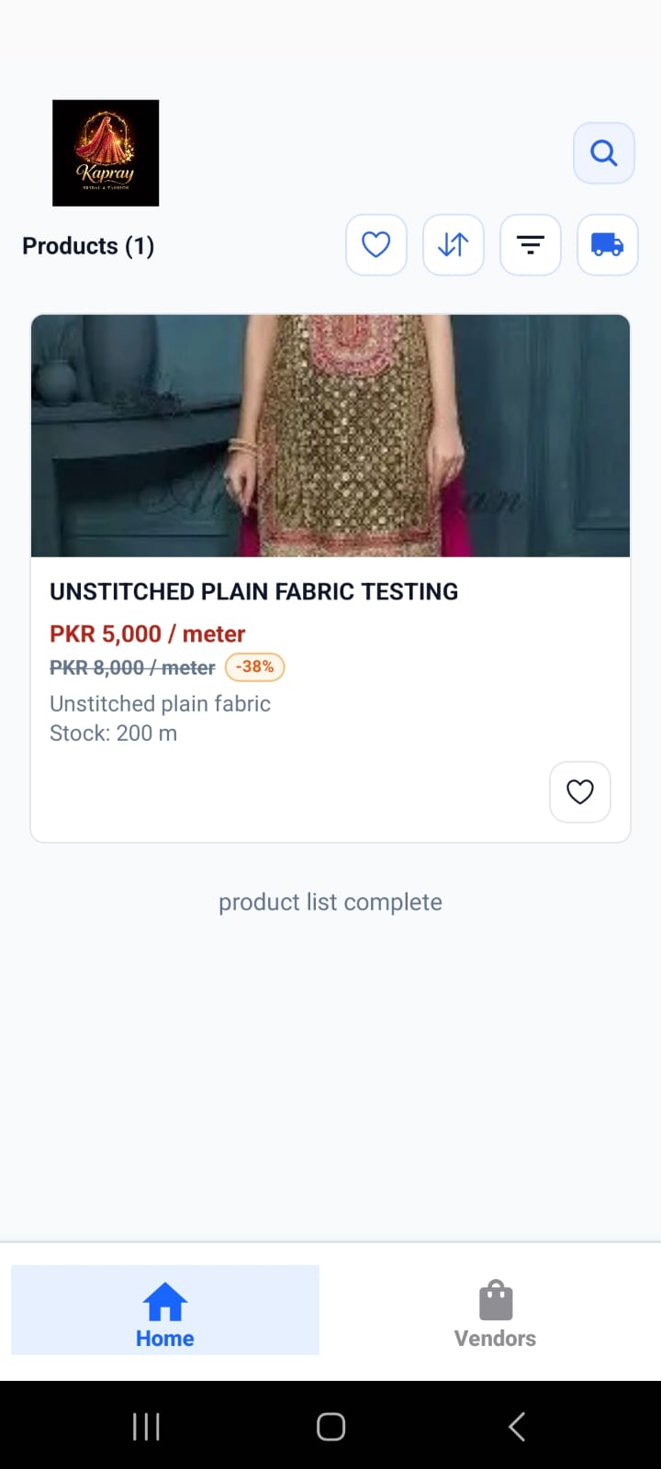
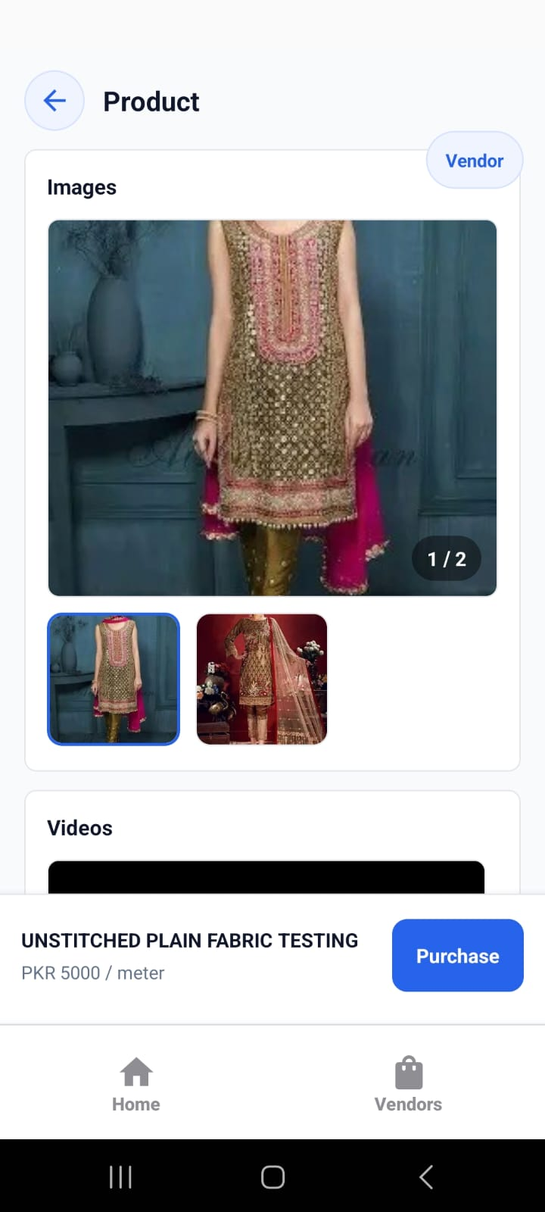
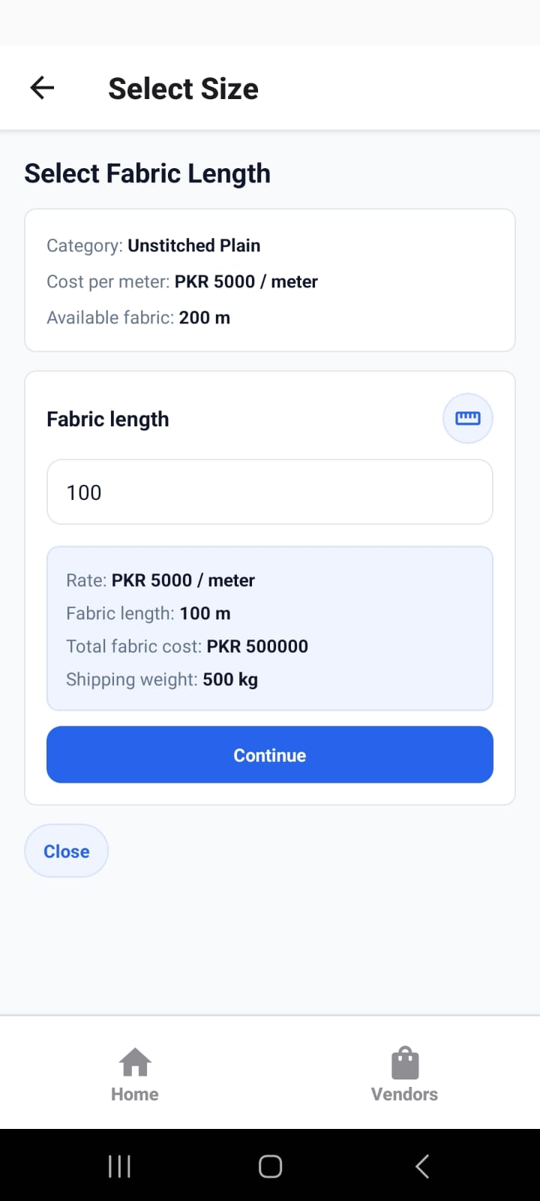
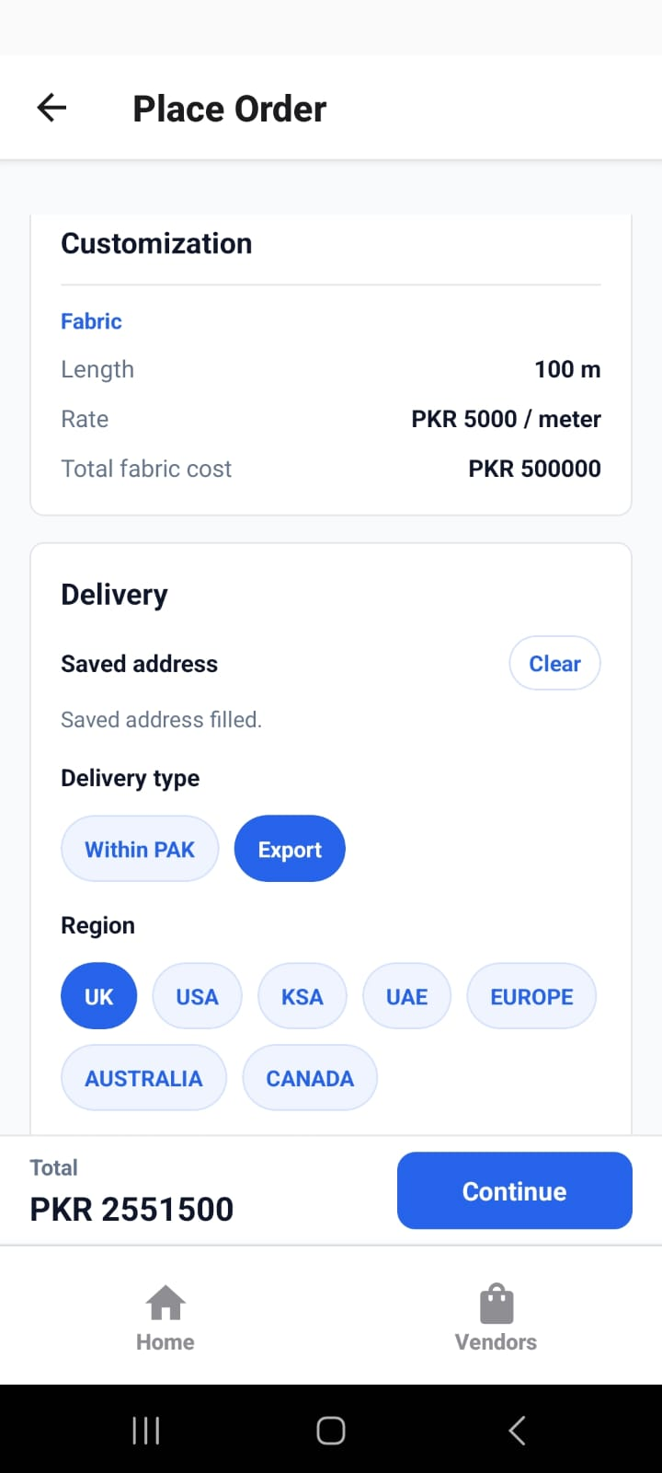
Buyer views mirror the vendor setup
Once published, the customer sees the catalogue, product media, size or fabric choices, and delivery options created by the vendor.
Catalogue
Product view
Fabric length
Delivery options
08
Notes:
[Sources]
User-provided Kapray screenshots: IMG-20260703-WA0218.jpg, IMG-20260703-WA0220.jpg, IMG-20260703-WA0224.jpg, IMG-20260703-WA0227.jpg

Slide 9
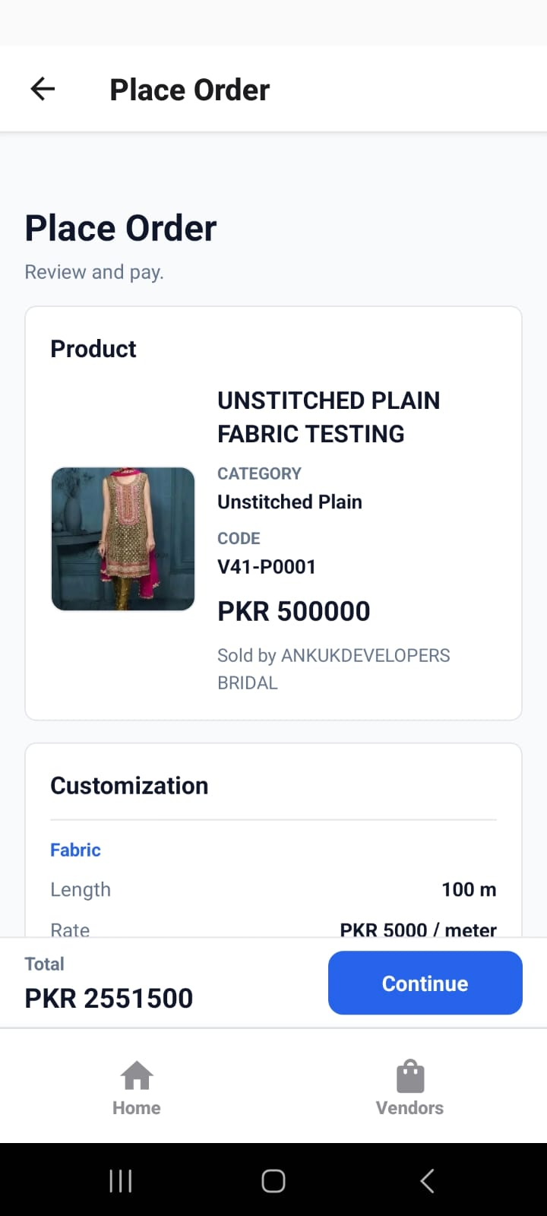
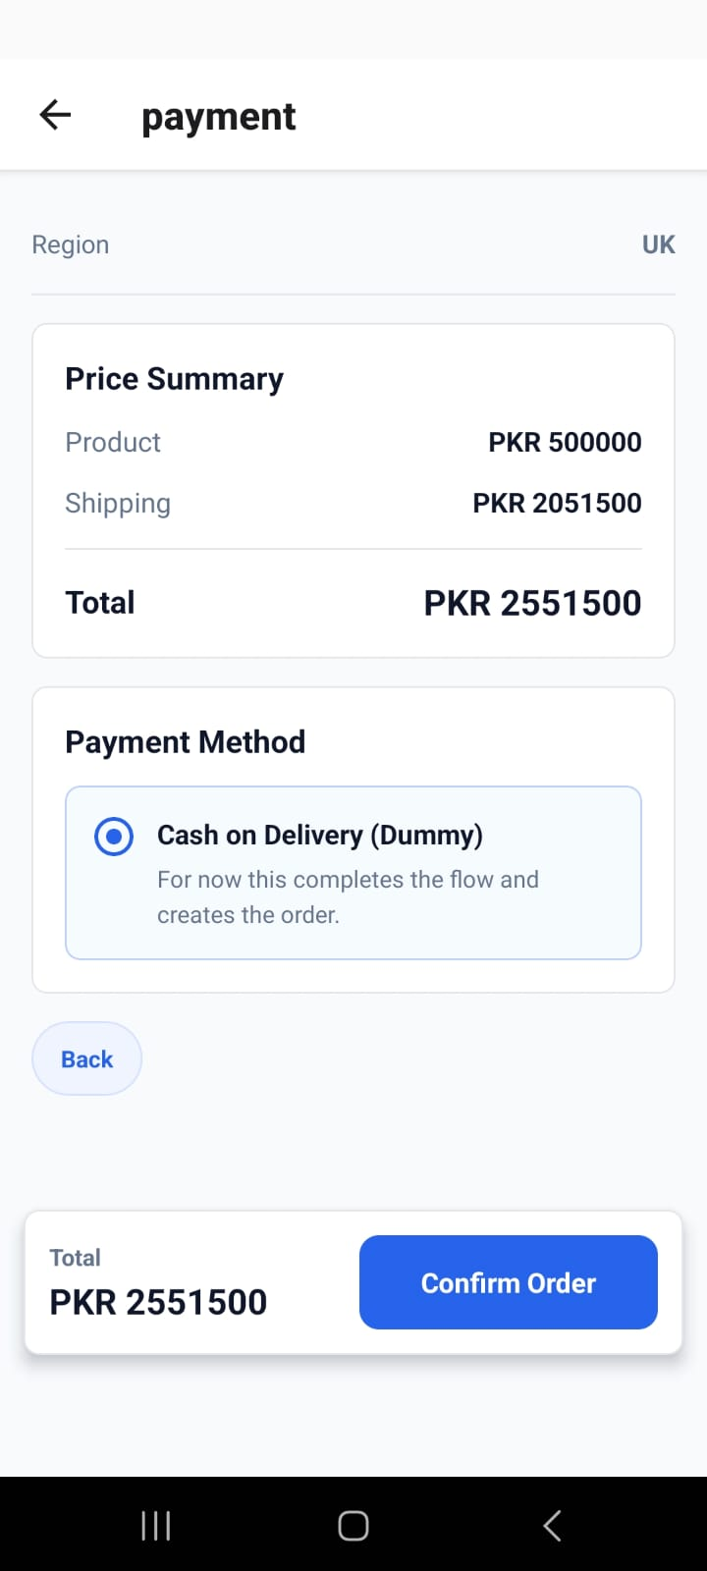
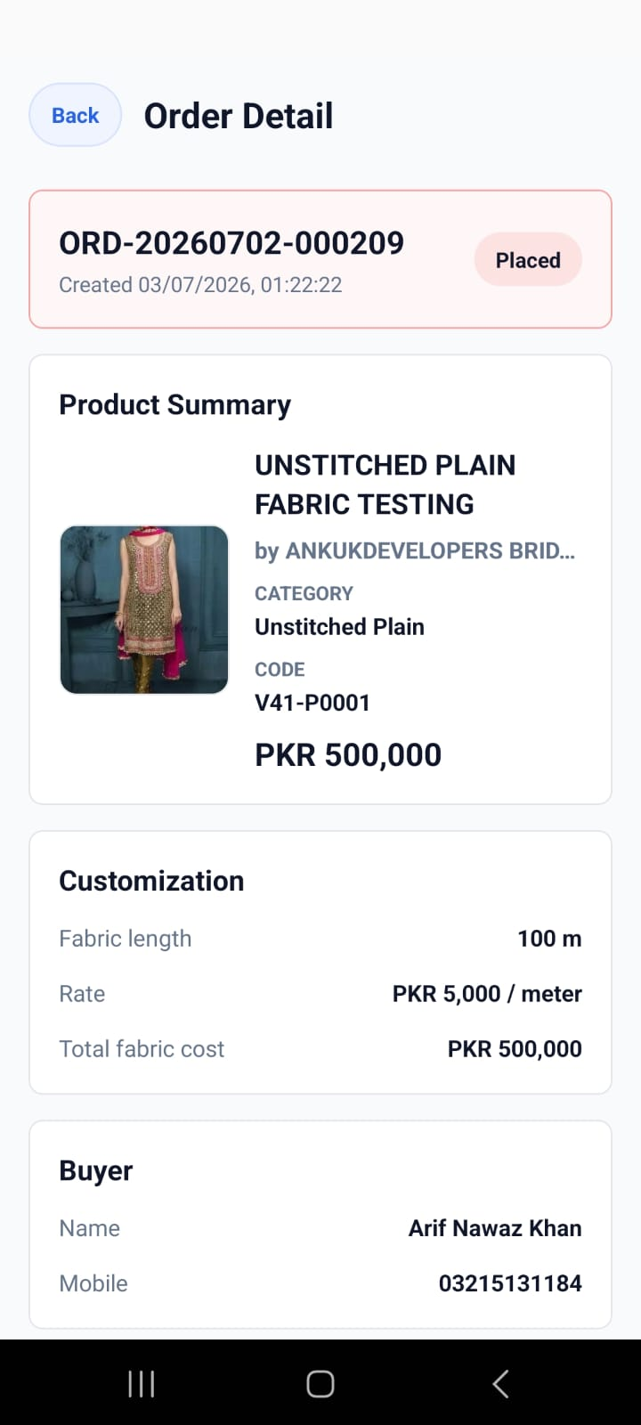
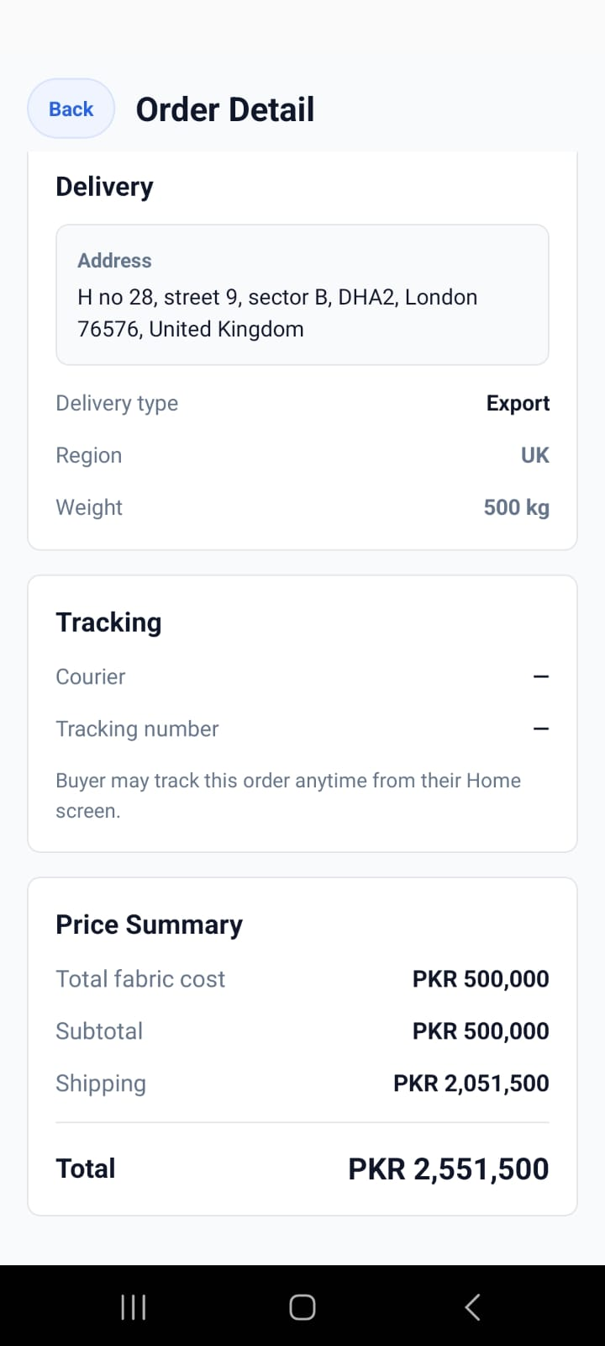
Orders keep buyer choices through fulfilment
Order detail screens keep customization, buyer information, payment, delivery, shipping, and tracking together.
Place order
Payment
Order detail
Delivery tracking
09
Notes:
[Sources]
User-provided Kapray screenshots: IMG-20260703-WA0226.jpg, IMG-20260703-WA0234.jpg, IMG-20260703-WA0235.jpg, IMG-20260703-WA0236.jpg

Slide 10
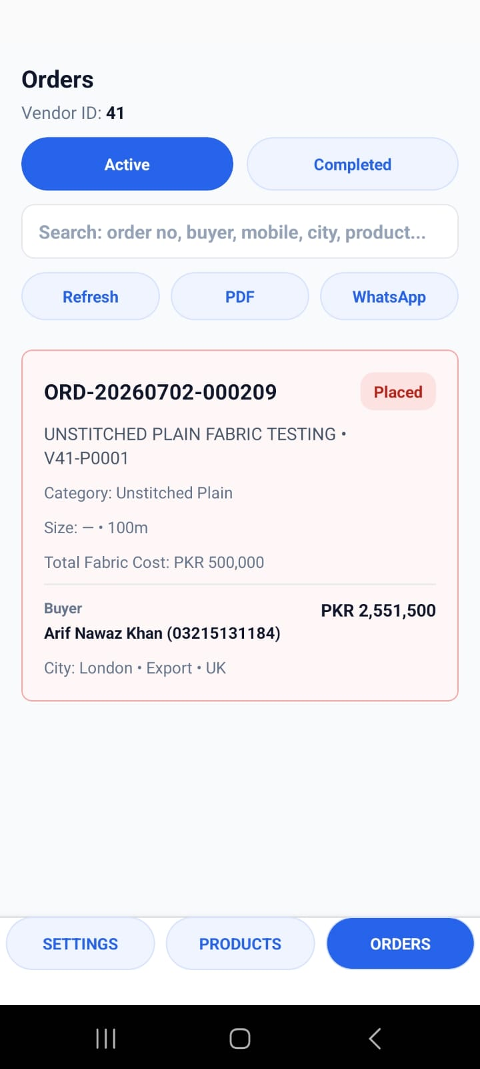
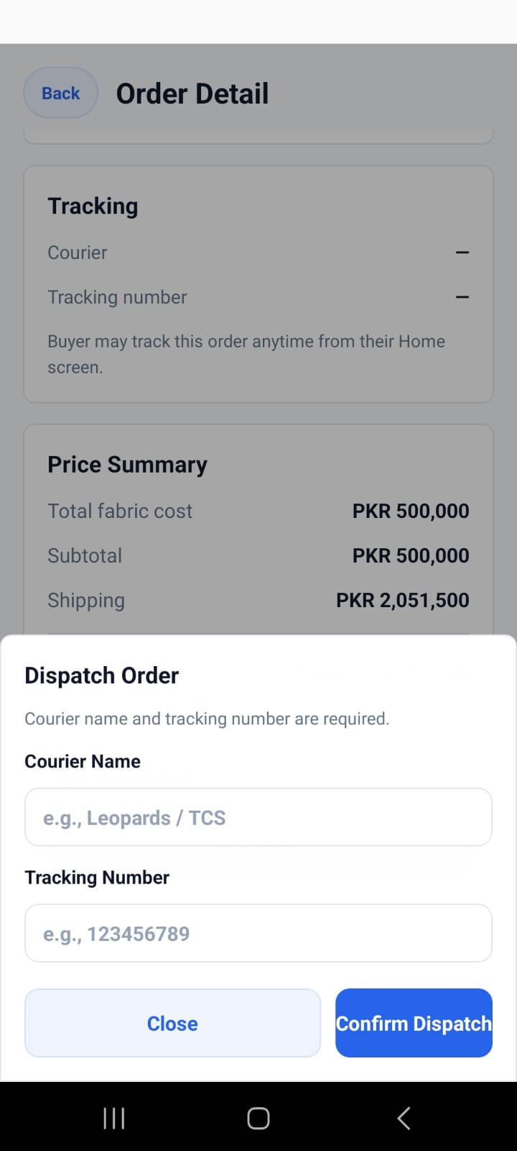
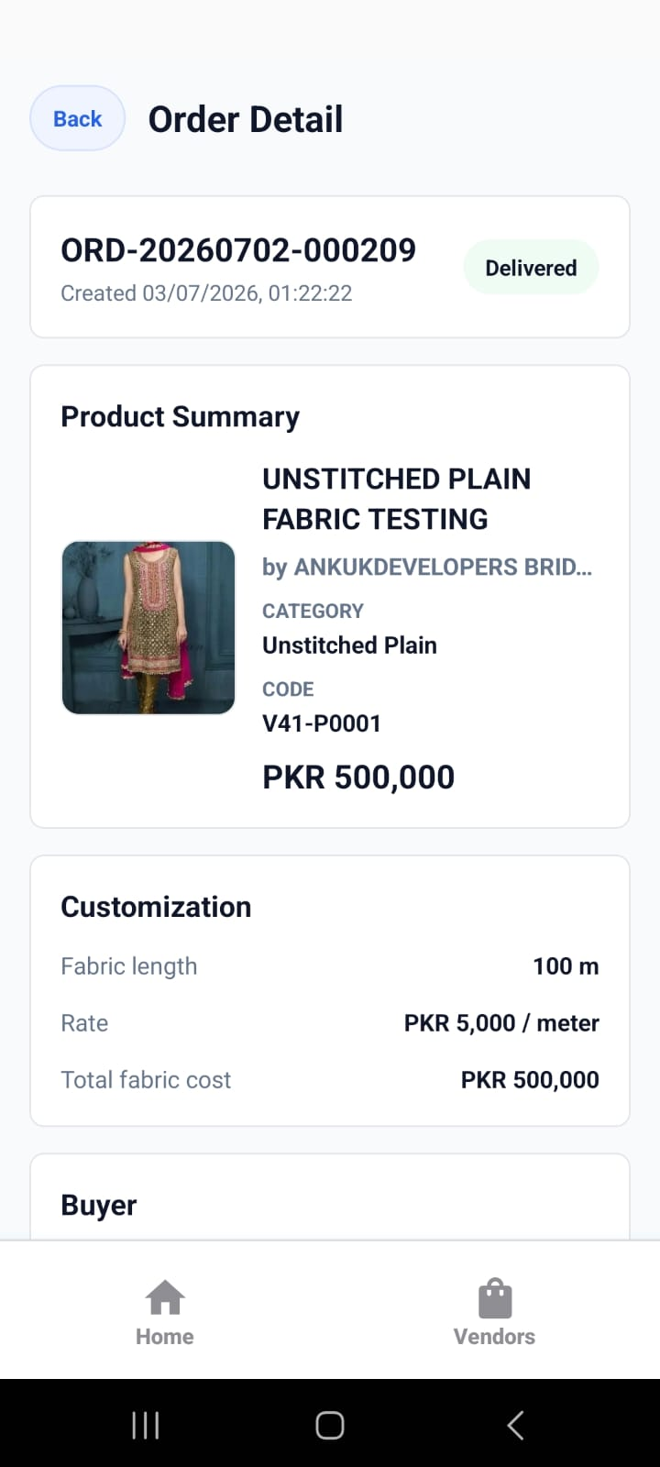
Fulfil orders from the order detail
The order moves through packed, dispatched with courier details, and delivered states.
Orders tab
Mark packed
Dispatch
Delivered
10
Notes:
[Sources]
User-provided Kapray screenshots: IMG-20260703-WA0246.jpg, IMG-20260703-WA0247.jpg, IMG-20260703-WA0249.jpg, IMG-20260703-WA0252.jpg

Slide 11
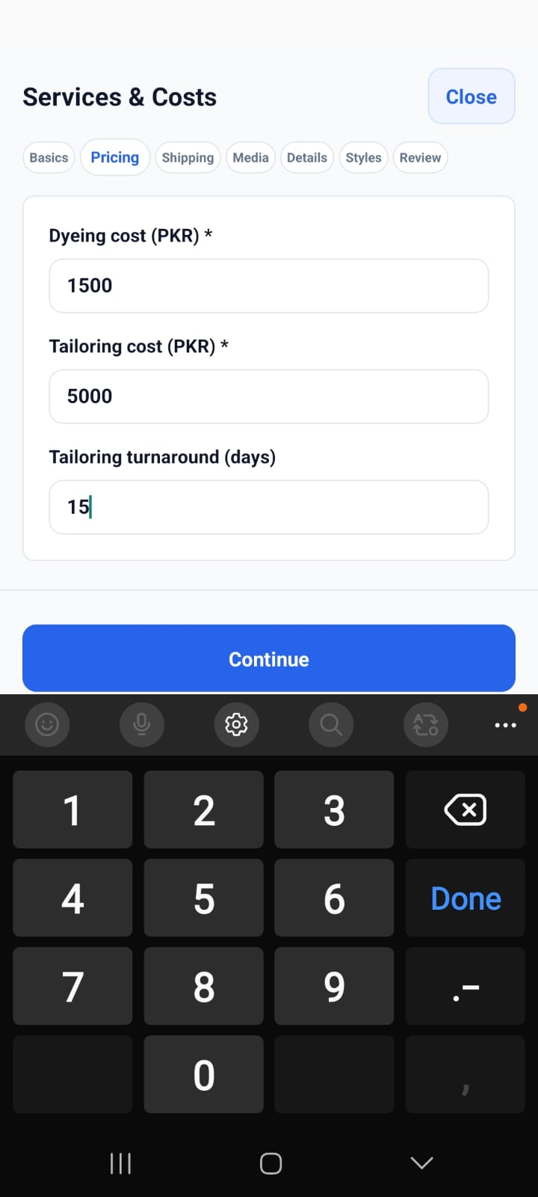
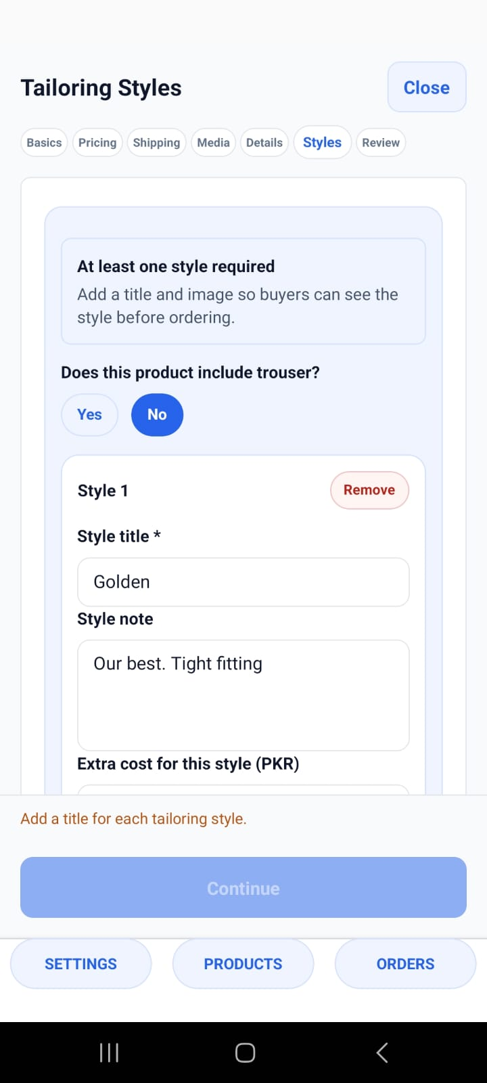
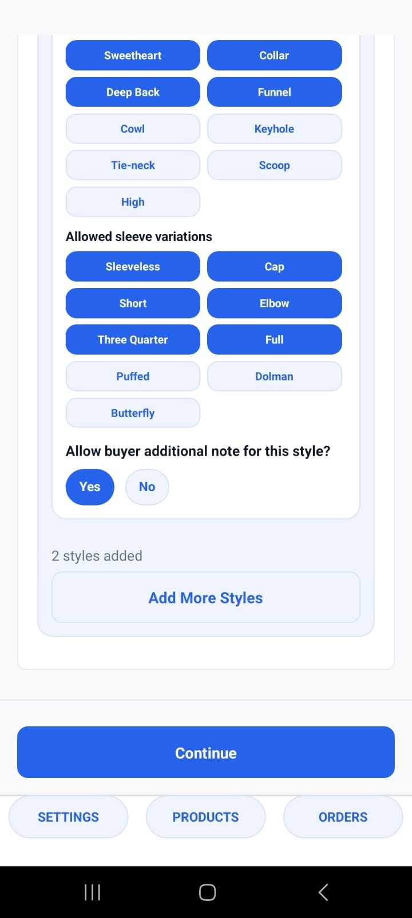
Dyeing and tailoring add service pricing
For unstitched products with services, vendors add dyeing cost, tailoring cost, turnaround time, and one or more tailoring styles.
1
Dyeing cost
2
Tailoring cost and days
3
Reusable style cards
Service costs
Tailoring styles
Saved styles
11
Notes:
[Sources]
User-provided Kapray screenshots: IMG-20260710-WA0009.jpg, IMG-20260710-WA0014.jpg, IMG-20260710-WA0018.jpg

Slide 12
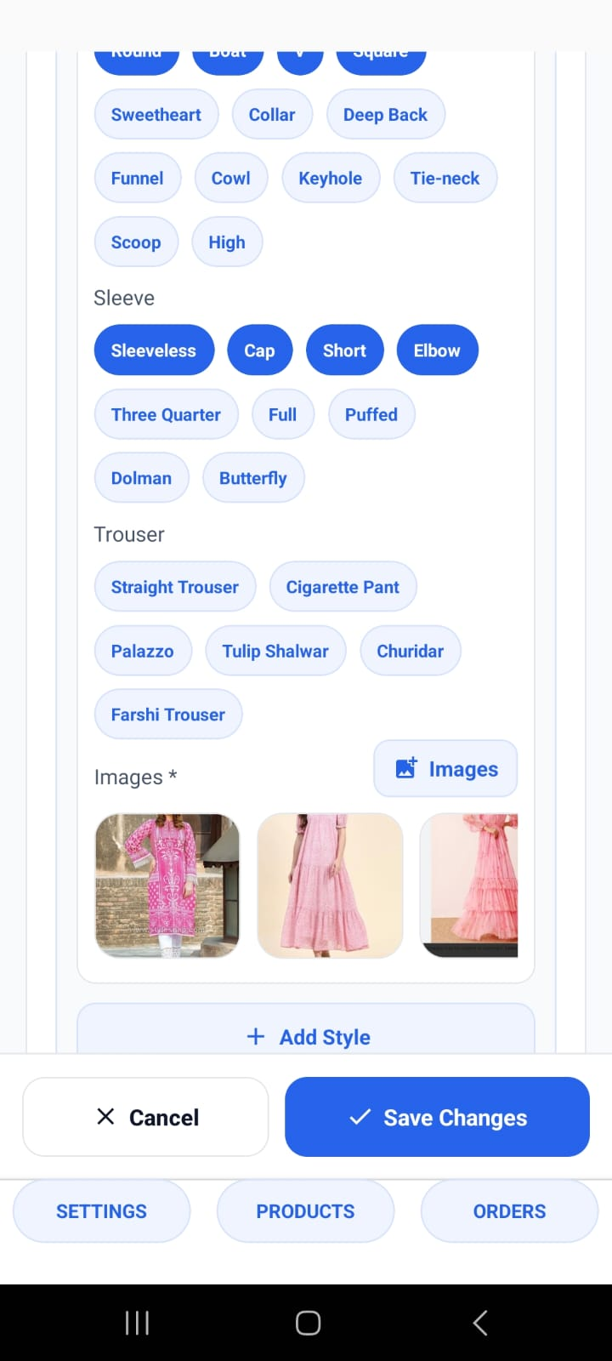
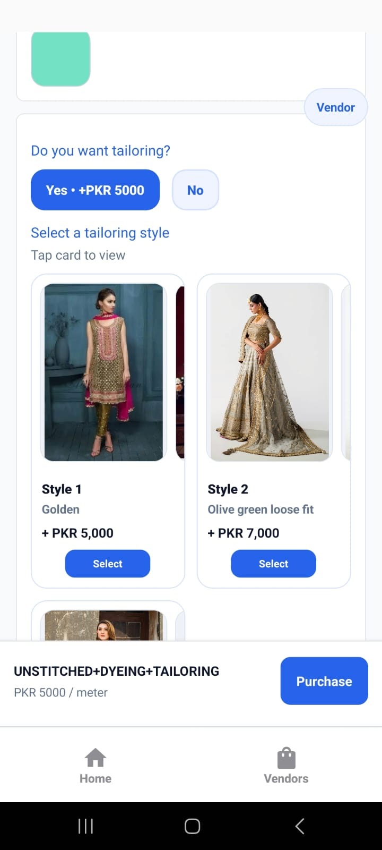
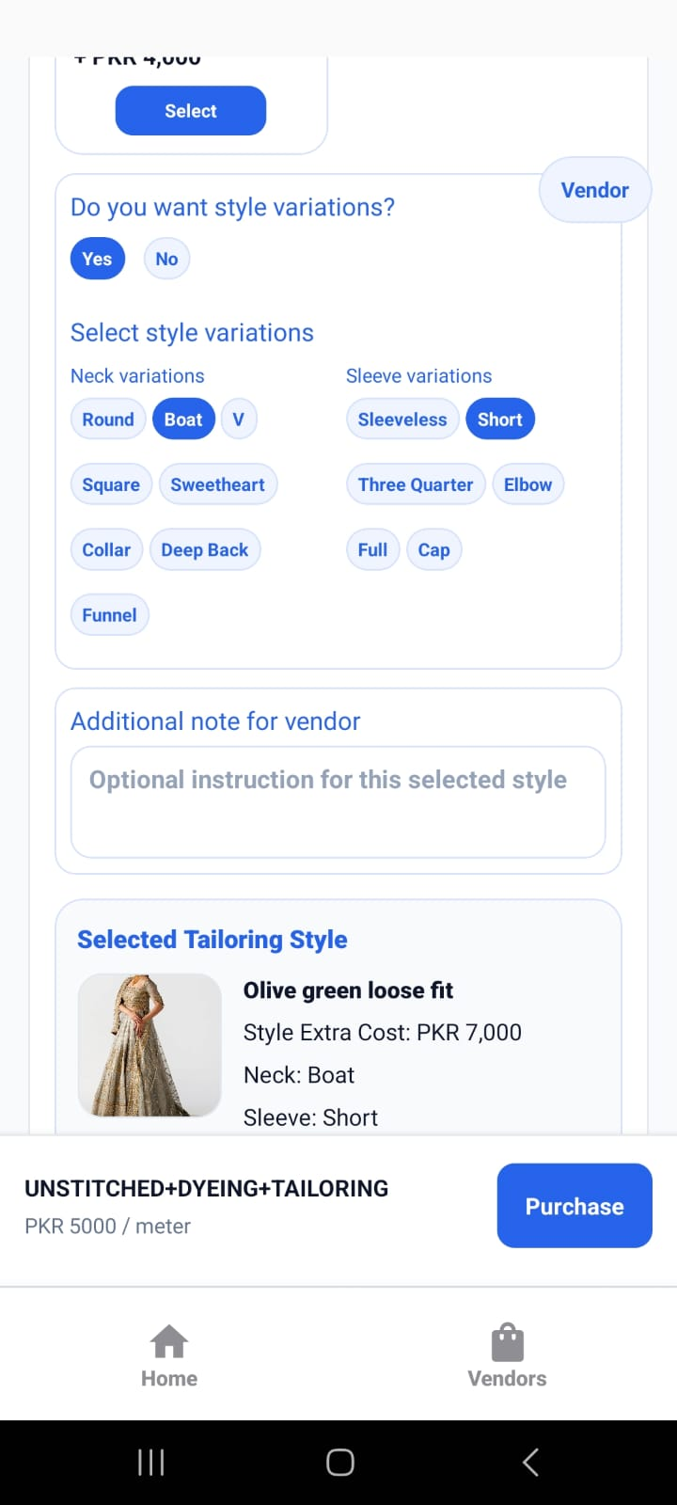
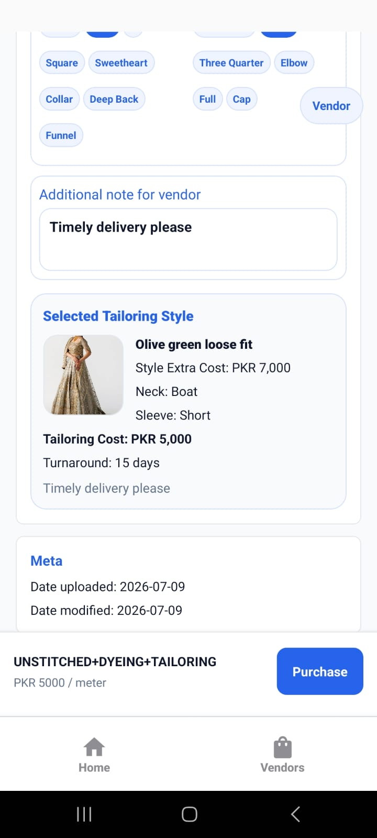
Tailoring styles become buyer choices
A style can include title, images, extra price, allowed necks, sleeves, trouser options, and additional instructions.
Edit style
Style cards
Variations
Vendor note
12
Notes:
[Sources]
User-provided Kapray screenshots: IMG-20260710-WA0027.jpg, IMG-20260710-WA0048.jpg, IMG-20260710-WA0054.jpg, IMG-20260710-WA0055.jpg

Slide 13
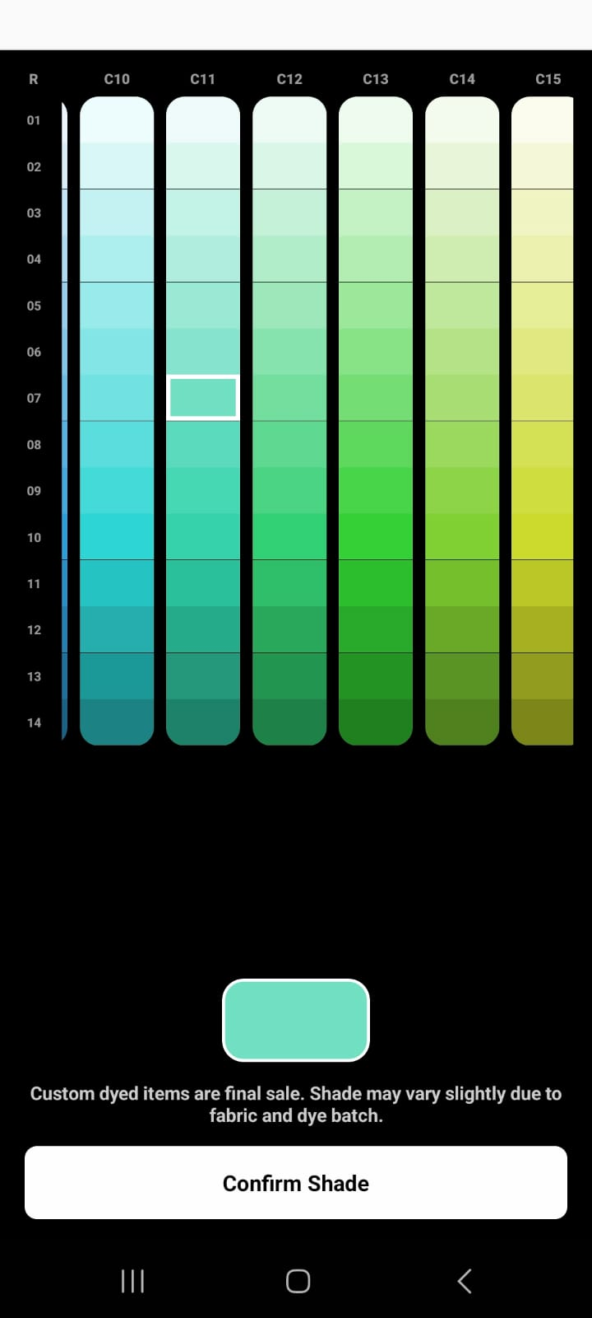
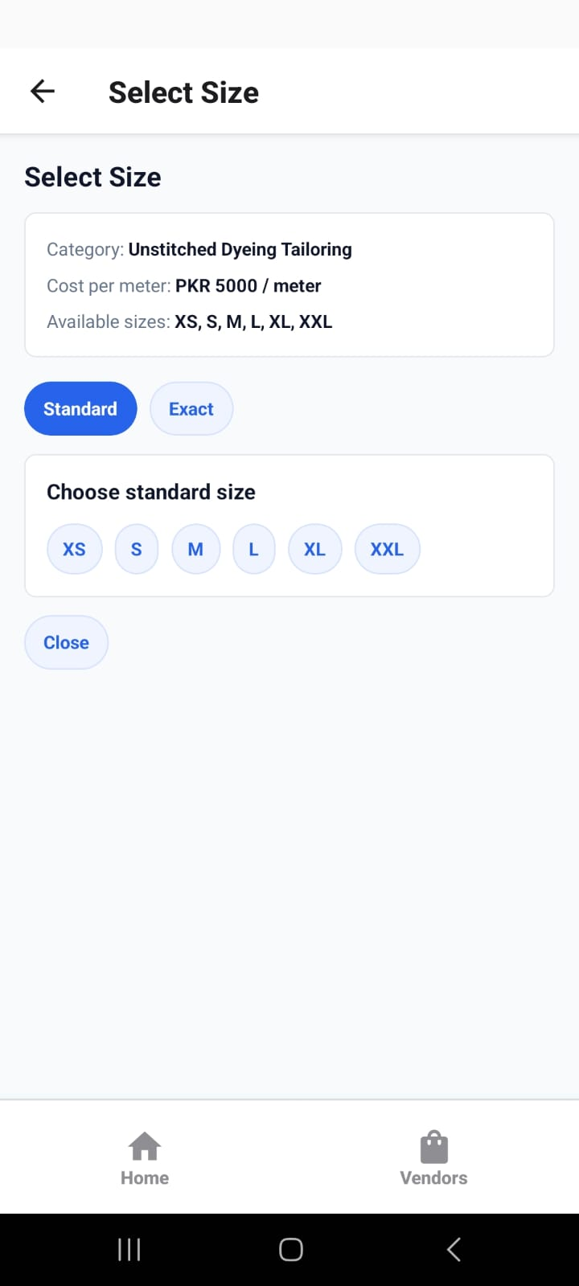
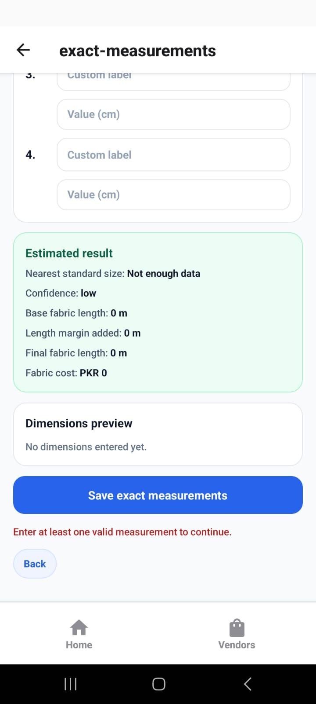
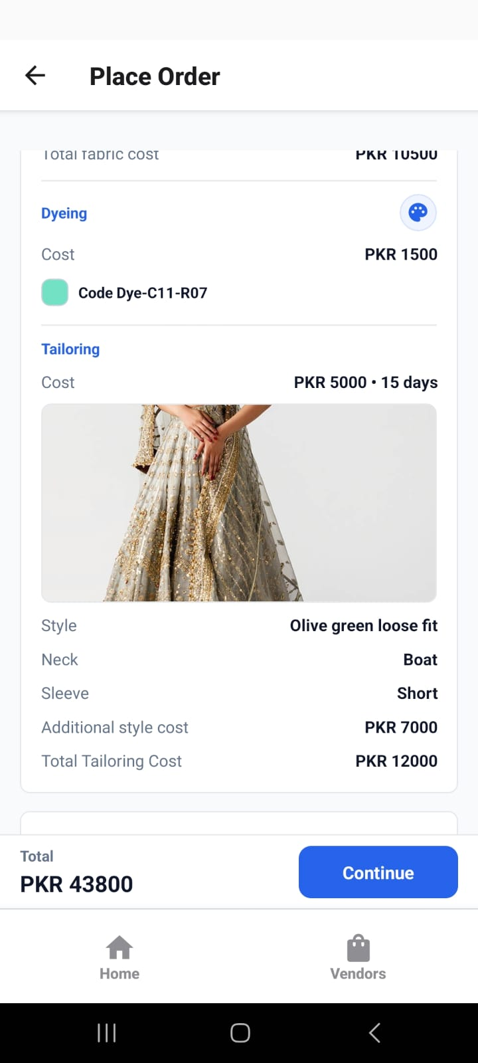
Custom orders collect shade, style, and measurements
The buyer can choose dye shade, tailoring style, standard or exact measurements, then review the full service cost in checkout.
Shade
Size choice
Measurements
Order summary
13
Notes:
[Sources]
User-provided Kapray screenshots: IMG-20260710-WA0046.jpg, IMG-20260710-WA0056.jpg, IMG-20260710-WA0061.jpg, IMG-20260710-WA0063.jpg

Slide 14
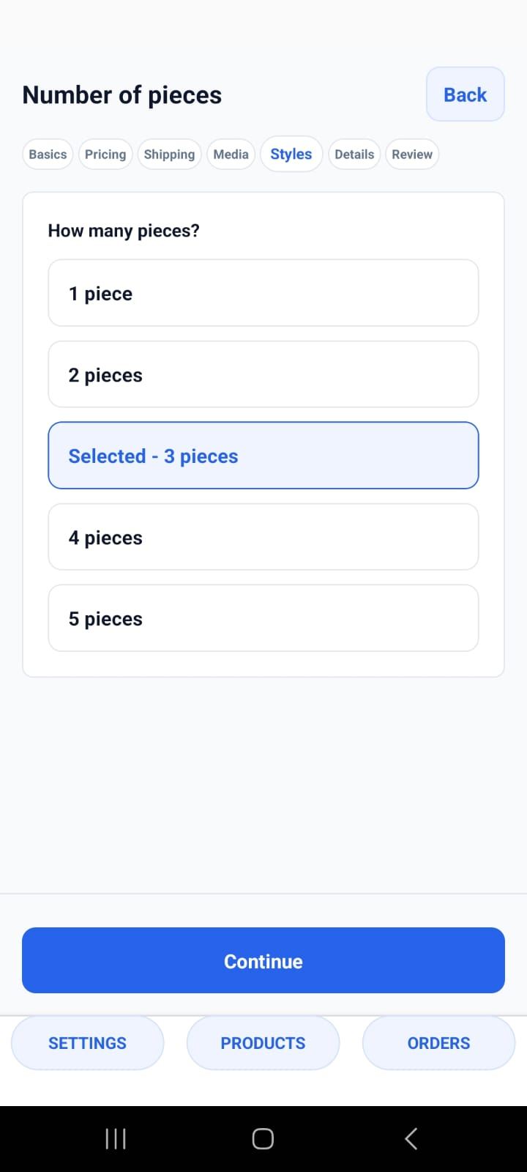
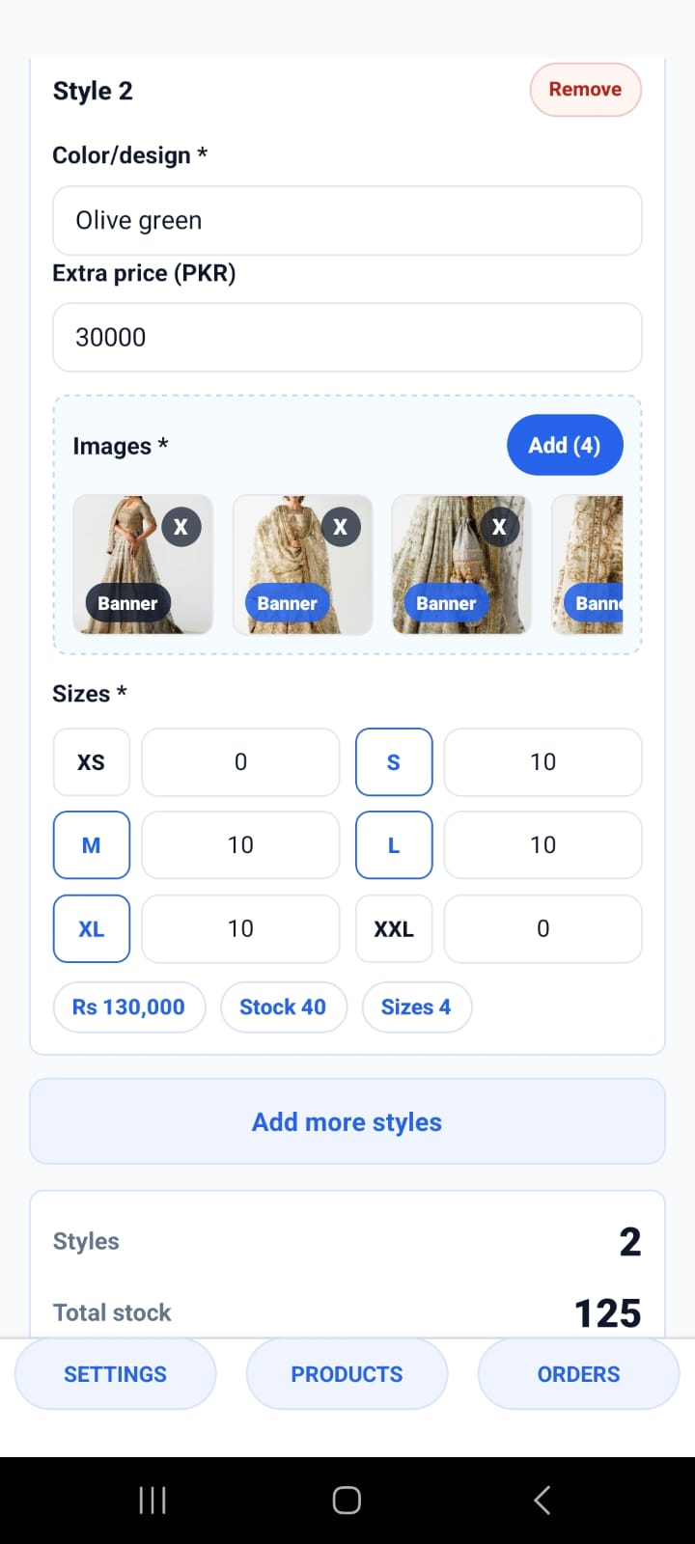
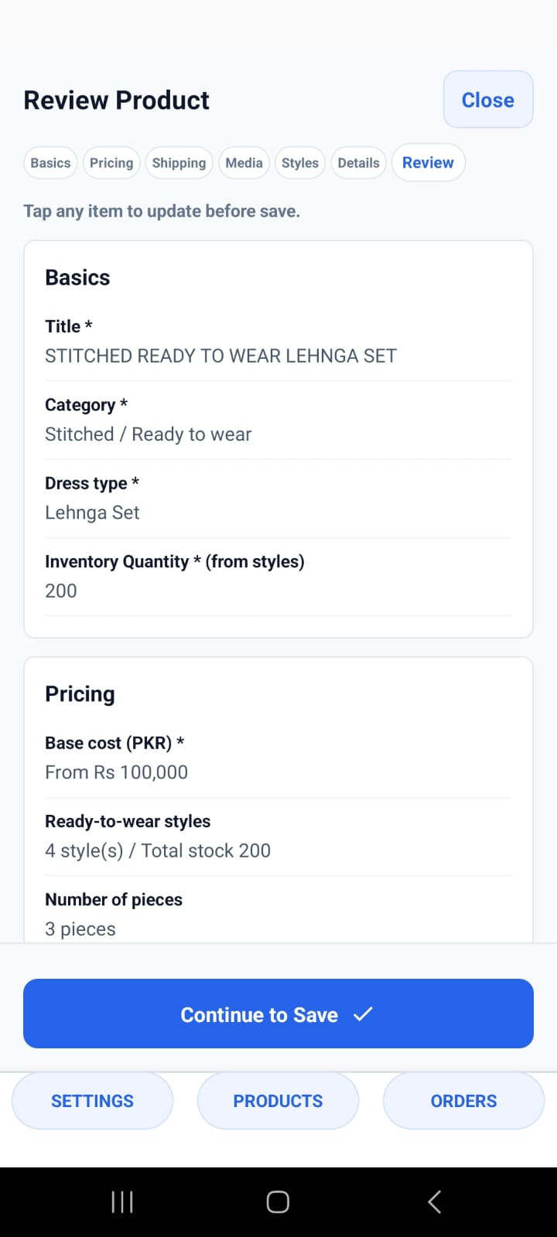
Ready-to-wear uses stock by style and size
This path is built for finished stock: choose ready-to-wear, define piece count, add styles, and assign inventory per size.
Ready-to-wear
Pieces
Style stock
Review
14
Notes:
[Sources]
User-provided Kapray screenshots: IMG-20260710-WA0084.jpg, IMG-20260710-WA0090.jpg, IMG-20260710-WA0093.jpg, IMG-20260710-WA0098.jpg

Slide 15
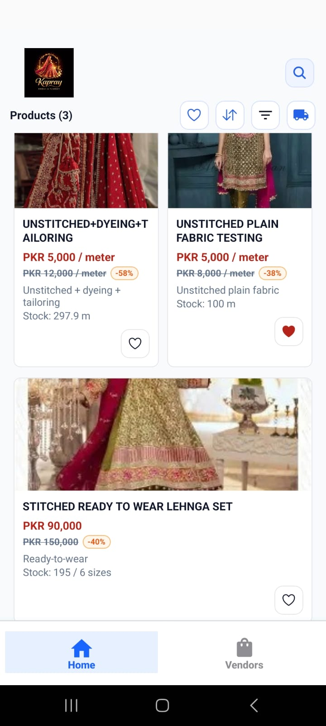
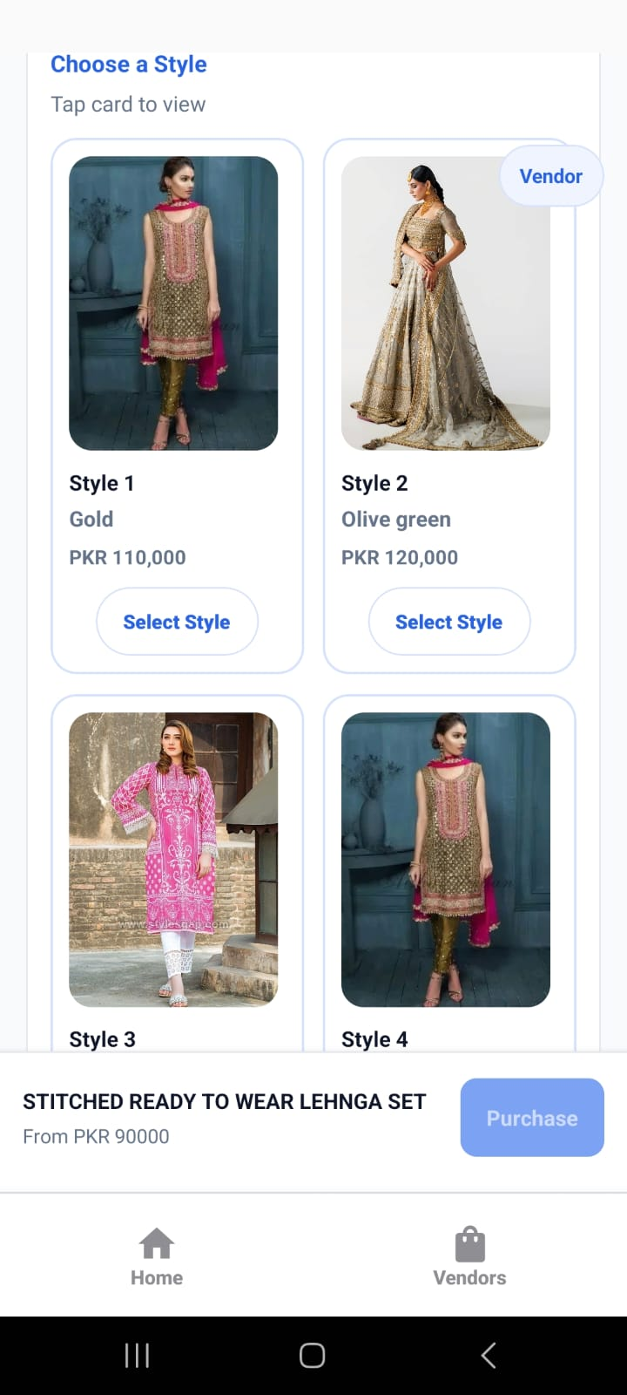
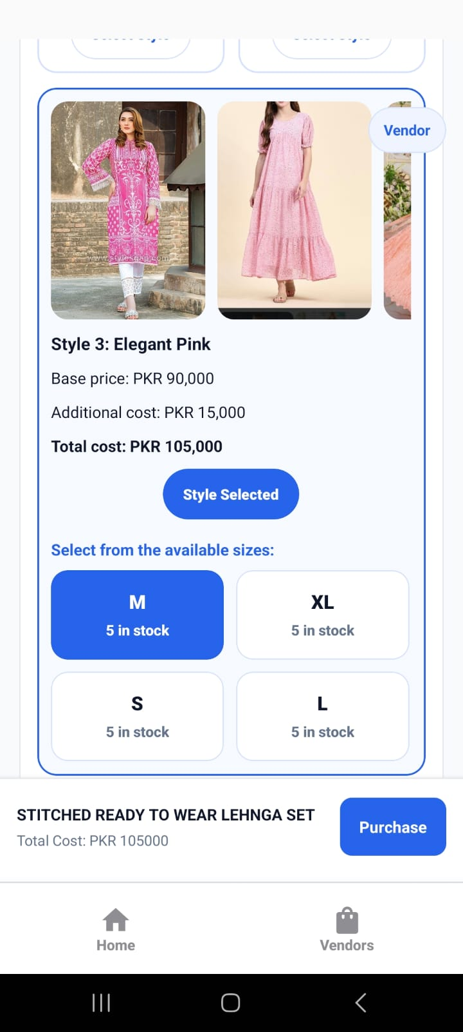
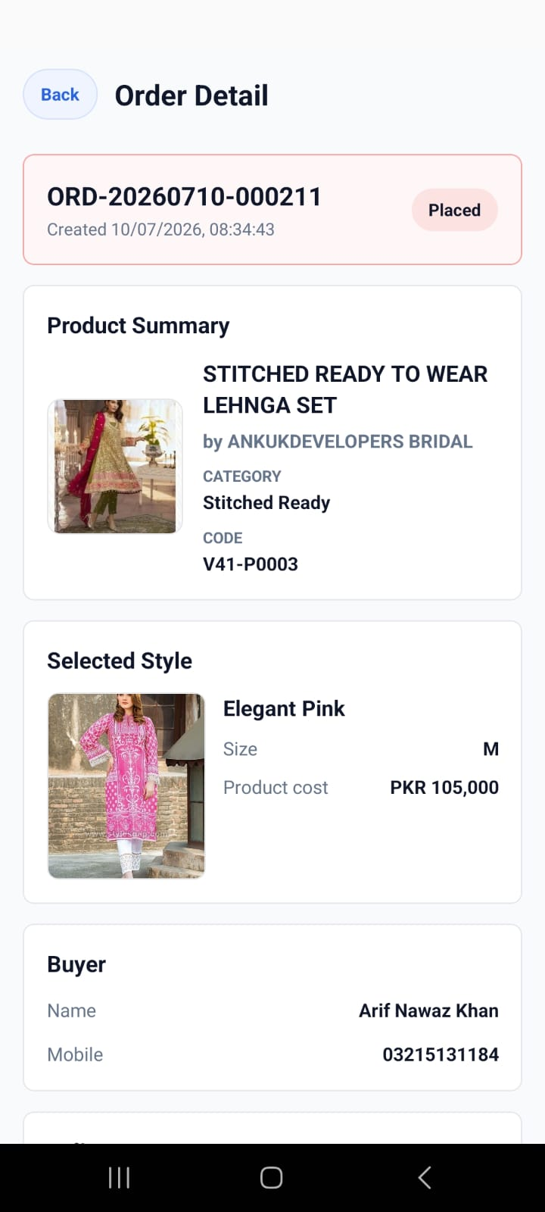
Ready-to-wear buyers choose style, then size
The buyer journey stays simple because vendor stock rules are already structured by style and size.
Catalogue
Choose style
Choose size
Order detail
15
Notes:
[Sources]
User-provided Kapray screenshots: IMG-20260710-WA0118.jpg, IMG-20260710-WA0122.jpg, IMG-20260710-WA0125.jpg, IMG-20260710-WA0130.jpg

Slide 16
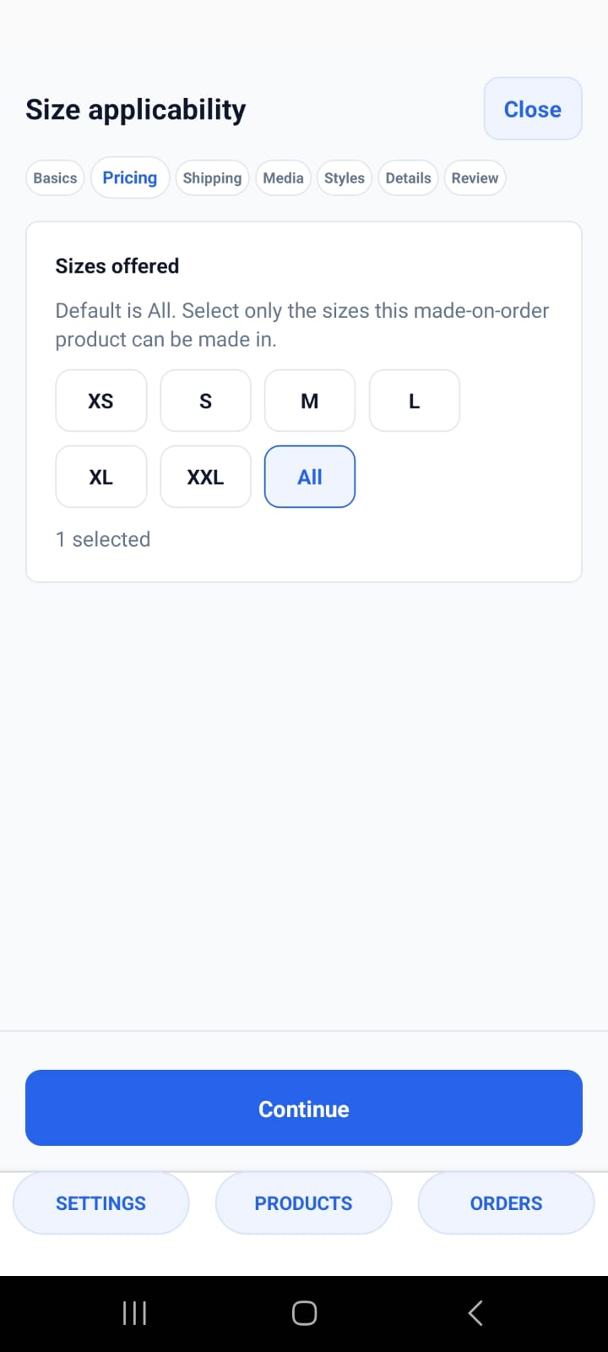



Made-to-order focuses on design and lead time
The setup flow captures allowed sizes, package/shipping rules, design names, additional price, and estimated days.
Size applicability
Shipping
Design
Review
16
Notes:
[Sources]
User-provided Kapray screenshots: IMG-20260712-WA0025.jpg, IMG-20260712-WA0028.jpg, IMG-20260712-WA0031.jpg, IMG-20260712-WA0040.jpg

Slide 17



Vendor profile builds trust behind the catalogue
The app keeps shop identity, services, contact, regions, product list, and catalogue visibility close together so buyers know who is fulfilling the order.
1
Shop identity
2
Services and regions
3
Live catalogue
Profile
Services
Catalogue
17
Notes:
[Sources]
User-provided Kapray screenshots: IMG-20260712-WA0022.jpg, IMG-20260712-WA0023.jpg, IMG-20260710-WA0135.jpg

Slide 18
Onboarding checklist for the first product
A smooth vendor session starts with product and fulfilment information ready to enter.
1
Shop logo, shop name, contact, address, service areas, and export regions.
5
Inventory: fabric length, stock by size, or design availability.
2
Product path: unstitched plain, dyeing, tailoring, ready-to-wear, or made-to-order.
6
Shipping: weight, package dimensions, delivery type, courier, and tracking process.
3
Product media: clear images, optional video, and style-specific photos.
7
Order owner: who packs, dispatches, updates tracking, and marks delivery complete.
4
Pricing: base price, sale price rules, service add-ons, and style extra costs.
Recommended live exercise: add one real product, preview it as a buyer, place a test order, and move it through delivery.
18
Notes:
[Sources]
User-provided context: WhatsApp Chat with Kapray vendors onboarfing.txt

